Slide 1
Efficiency of HIV services in Nigeria: Determinants of unit cost variation of HIV counseling and testing and prevention of mother-to-child transmission interventions
by Bautista-Arredondo et al. (2018)
Replicated by Adeline (Haining) Yuan

Slide 2
Brief Summary
The paper examines the unit cost variation of HIV services in Nigeria—specifically HIV Counseling and Testing (HCT) and Prevention of Mother-to-Child Transmission (PMTCT)—using data from local health facilities.
The authors apply a log-linear OLS regression model to identify how factors like scale (volume of services), service delivery models (e.g. task-shifting, level of care, integration), and management practices (e.g. performance incentives, community involvement) affect unit costs.

Slide 3
Key Findings
Individual incentives and community involvement associated with lower unit costs.
External supervision and government budget control associated with higher unit costs.
Performance-based funding increased PMTCT costs slightly.
Competence score (proxy for quality) not significantly related to cost.

Slide 4
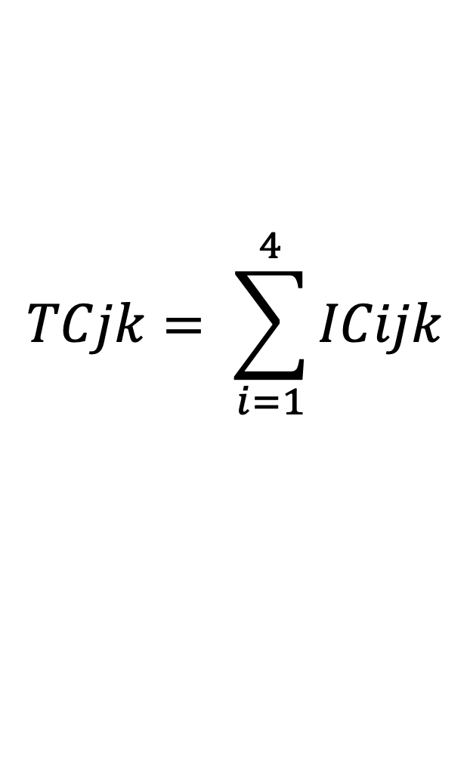
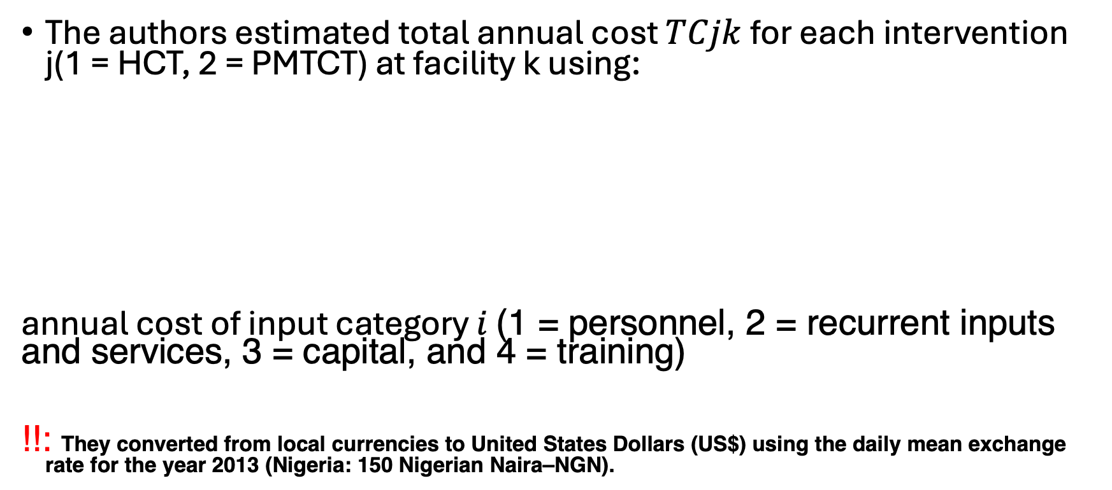
Unit cost estimation
The authors estimated total annual cost $TCjk$for each intervention j(1 = HCT, 2 = PMTCT) at facility k using:
annual cost of input category $i$ (1 = personnel, 2 = recurrent inputs and services, 3 = capital, and 4 = training)
!!: They converted from local currencies to United States Dollars (US$) using the daily mean exchange rate for the year 2013 (Nigeria: 150 Nigerian Naira–NGN).
$$TCjk= \sum_{i=1}^{4}{ICijk}$$

Slide 5
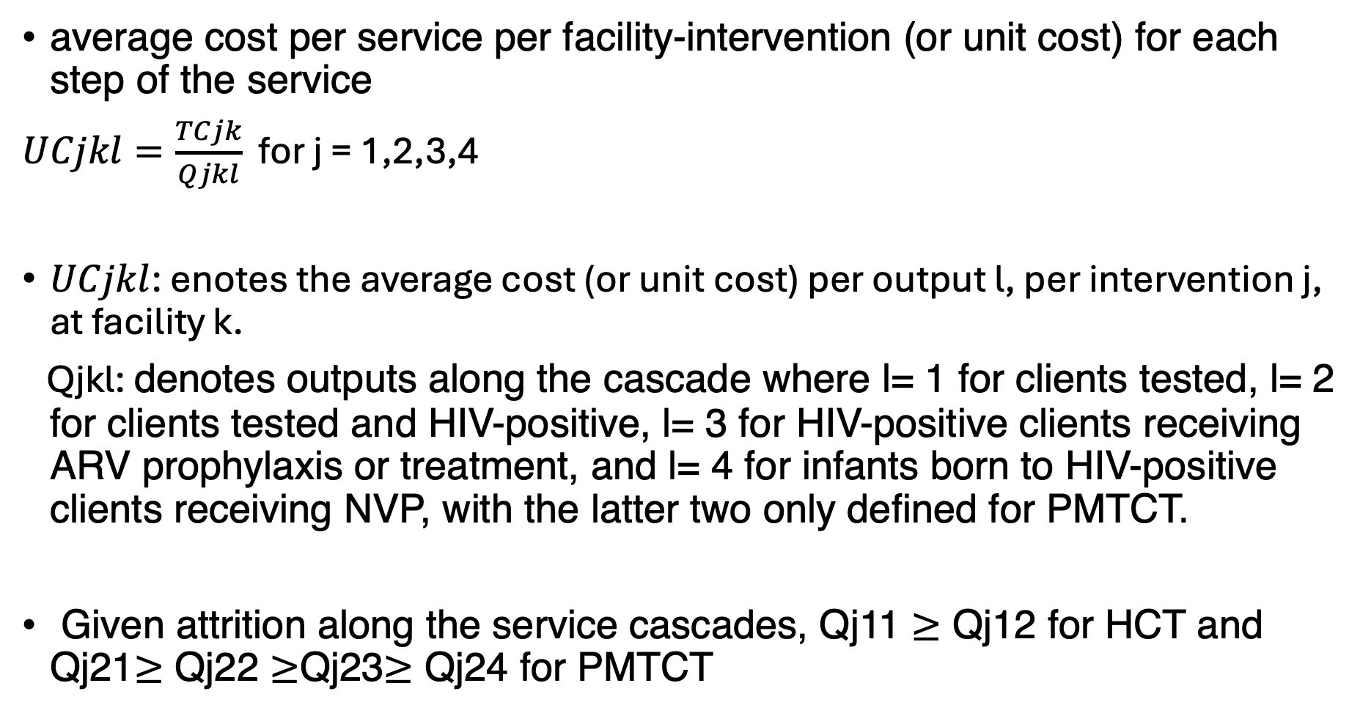
average cost per service per facility-intervention (or unit cost) for each step of the service
$UCjkl=\frac{TCjk}{Qjkl}$ for j = 1,2,3,4
$UCjkl$: enotes the average cost (or unit cost) per output l, per intervention j, at facility k.
Qjkl: denotes outputs along the cascade where l= 1 for clients tested, l= 2 for clients tested and HIV-positive, l= 3 for HIV-positive clients receiving ARV prophylaxis or treatment, and l= 4 for infants born to HIV-positive clients receiving NVP, with the latter two only defined for PMTCT.
Given attrition along the service cascades, Qj11 $≥$ Qj12 for HCT and Qj21$≥$ Qj22 $≥$Qj23$≥$ Qj24 for PMTCT

Slide 6
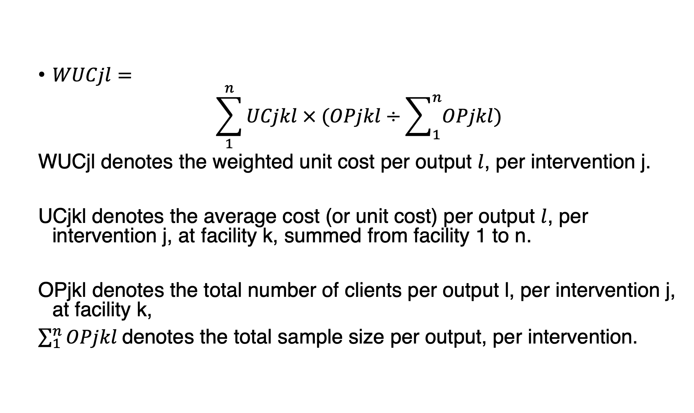
Estimation of weighted unit costs
$WUCjl=$
$$\sum_{1}^{n}{UCjkl × (OPjkl}÷\sum_{1}^{n}{OPjkl)}$$
WUCjl denotes the weighted unit cost per output $l$, per intervention j.
UCjkl denotes the average cost (or unit cost) per output $l$, per intervention j, at facility k, summed from facility 1 to n.
OPjkl denotes the total number of clients per output l, per intervention j, at facility k,
$\sum_{1}^{n}{OPjkl }$denotes the total sample size per output, per intervention.

Slide 7
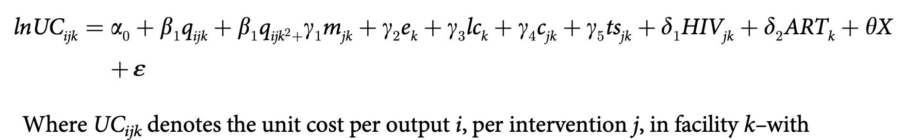
Determinants of unit cost variation
HCT (j=1) and PMTCT (j= 2); and i= 1 for clients tested, i= 2 for HIV-positive clients identified, i= 3 for HIV-positive
clients receiving ARV treatment or prophylaxis, and i= 4 for infants born to HIV-positive clients receiving NVP,
with the latter two defined only for PMTCT.
On the right hand-side of the equation, qijk is the number of annual output I from intervention j, at facility k; mjk
measures the number of years since facilities began providing the intervention j(maturity) in facility k;
ek is the average number of years of staff experience providing
HIV services in facility k; lck indicates the level of care of facility k; cjk is the average competence score for
intervention j in facility k;
tsjk is a binary variable indicating whether task shifting is used in providing the intervention jin facility k.
As a measure of integration of HIV services we included two additional variables;
HIVjk measures the annual number of clients of intervention j in facility k(with j=1when estimating UCi2k, andj=2 whenestimatingUCi1k); and ARTk, a binary variable indicating whether the facility provided antiretroviral therapy
(ART) or not. Finally, X is the vector of management indicators.

Slide 8
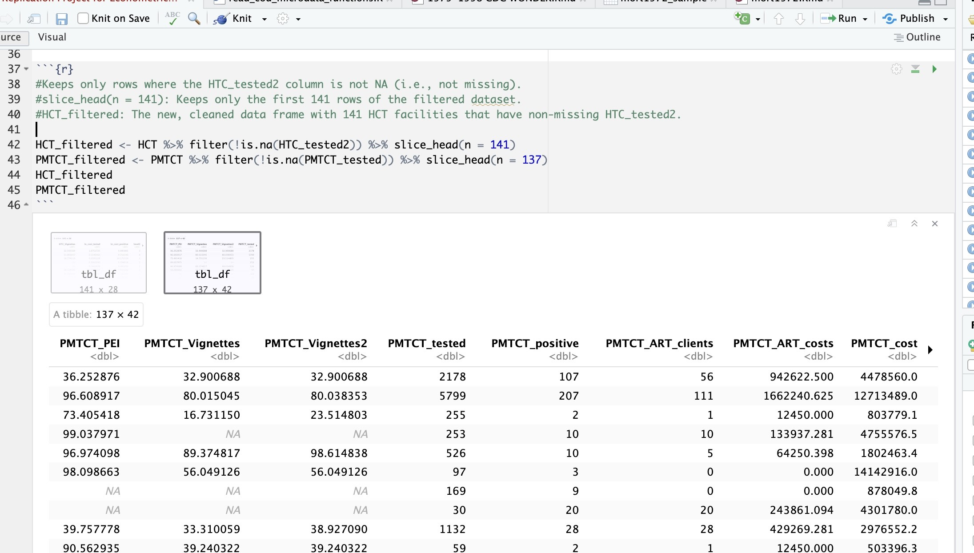
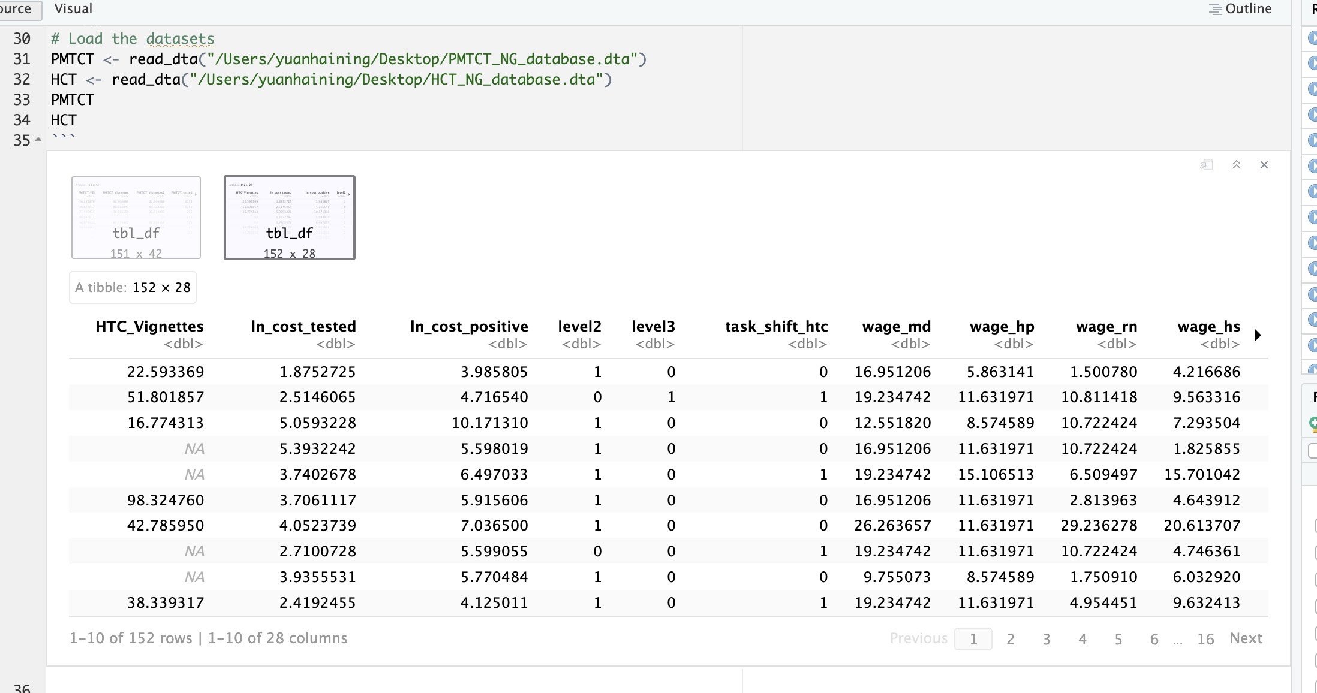
A Series of Replication Code👽
HCT_filtered <- HCT %>% filter(!is.na(HTC_tested2)) %>% slice_head(n = 141)
HCT: Your original data frame for HIV Counseling and Testing (HCT) facilities.
filter(!is.na(HTC_tested2)): Keeps only rows where the HTC_tested2 column is not NA (i.e., not missing).
slice_head(n = 141): Keeps only the first 141 rows of the filtered dataset.
HCT_filtered: The new, cleaned data frame with 141 HCT facilities that have non-missing HTC_tested2.
PMTCT_filtered <- PMTCT %>% filter(!is.na(PMTCT_tested)) %>% slice_head(n = 137)
Same logic, applied to the PMTCT data (Prevention of Mother-to-Child Transmission).

Slide 9
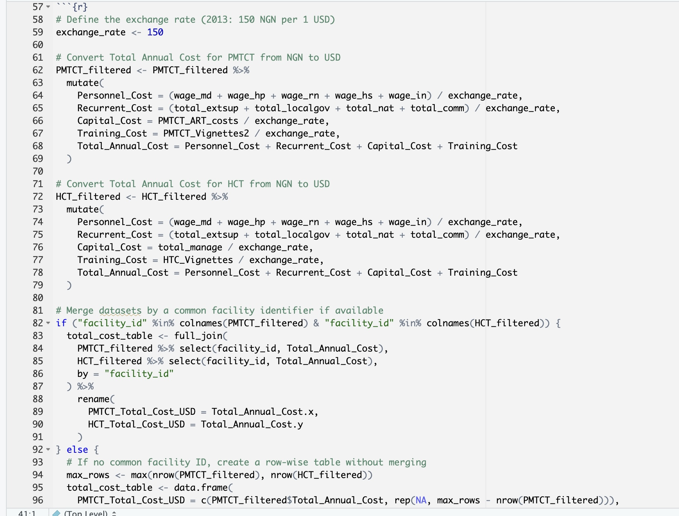
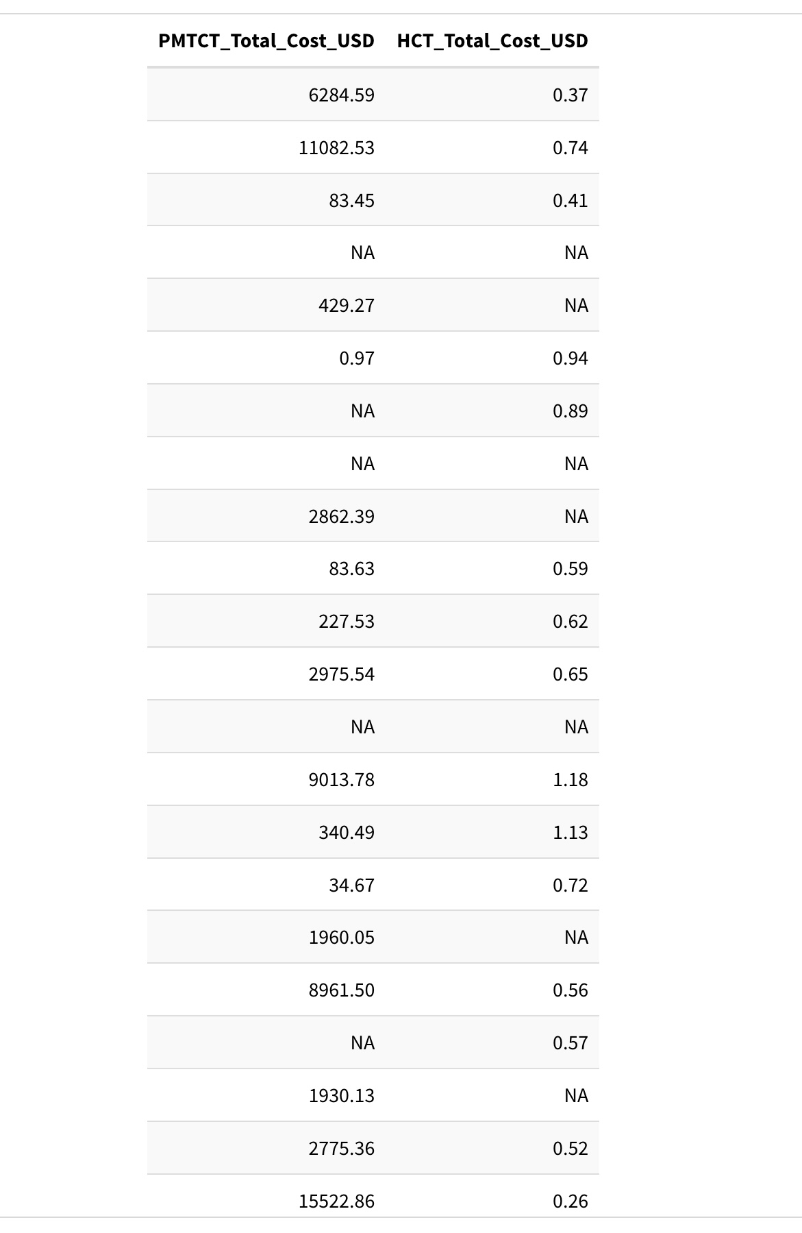
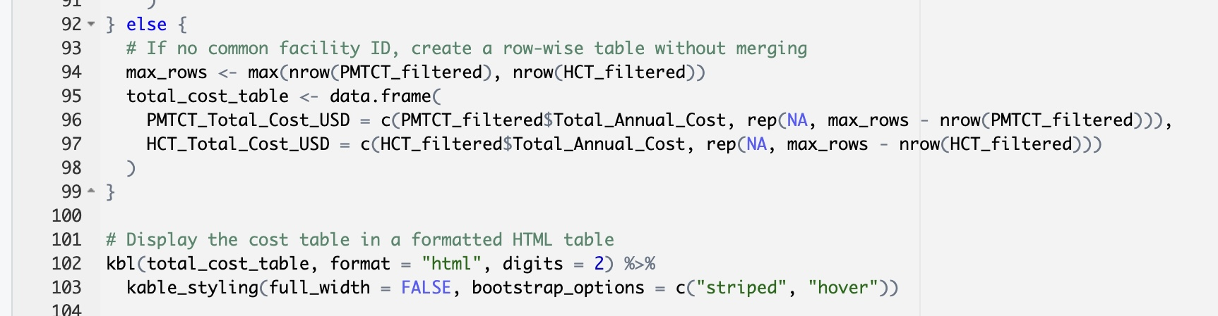

Slide 10
Complexity of Services：
HCT Services mainly include HIV testing and counseling, which require fewer medical resources.
PMTCT Services involve multiple interventions, including:
HIV testing for pregnant women
Provision of antiretroviral therapy (ART)
Monitoring and follow-ups
Nevirapine (NVP) treatment for infants
Delivery and postnatal care for HIV-positive mothers
PMTCT requires ongoing treatment and monitoring, whereas HCT is a one-time testing service for many clients.
Higher Cost of ART and Medication
PMTCT services include ART (Antiretroviral Therapy) for HIV-positive mothers and newborns, which significantly increases costs.
HCT does not involve direct treatment—only testing and referral, which is much cheaper.
The cost of providing lifelong ART to a mother and her child is far greater than a single HIV test.
Additional Personnel Costs：
PMTCT programs require more skilled health workers, such as obstetricians, pediatricians, and ART specialists, increasing personnel costs.
HCT primarily relies on nurses and counselors, which is a lower-cost workforce.
Infrastructure and Training Costs
PMTCT facilities require maternity services, ART dispensing units, and postnatal care, increasing infrastructure costs.
Training costs for PMTCT staff may be higher due to ART management, infant care, and adherence counseling.
Higher Operational Costs for PMTCT
PMTCT requires longer-term patient engagement, including follow-ups for mothers and infants.
Supply chain costs for PMTCT may be higher due to the distribution of ART drugs and maternal health supplements.

Slide 11
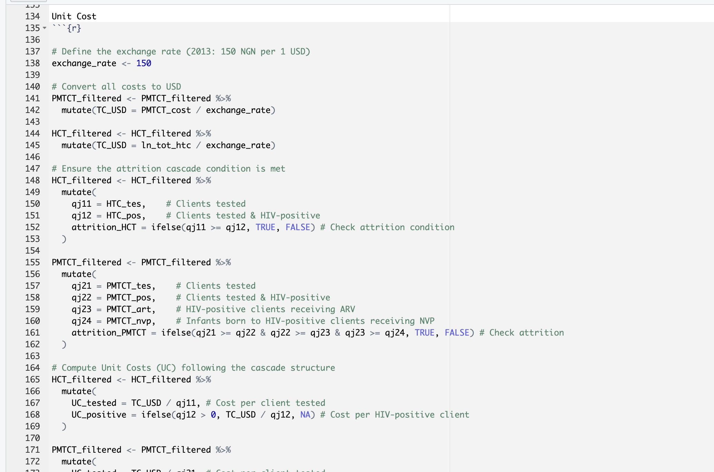
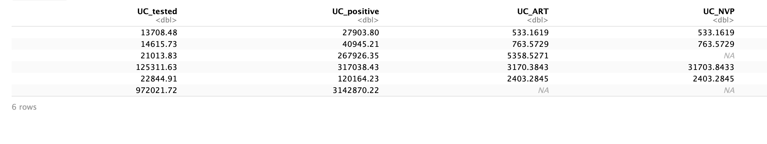
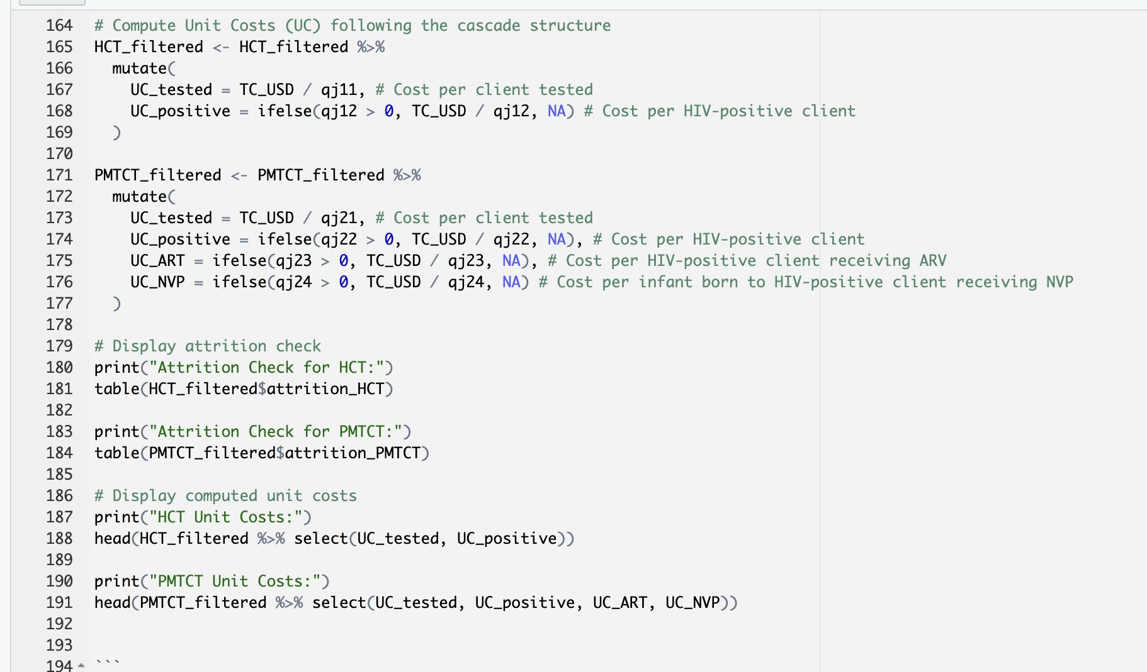
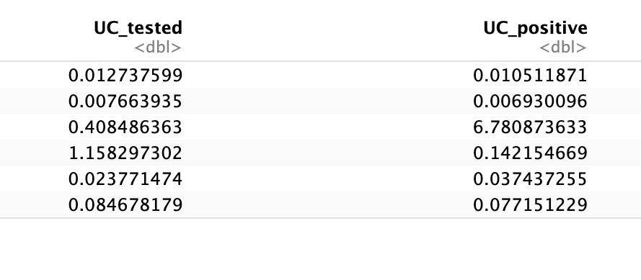
PMTCT_Unit Cost
HCT_Unit Cost
The reason why UC ART and UC NVP are the same is due to attrition patterns in the PMTCT cascade. If the number of HIV-positive women receiving ARV prophylaxis (q_{j23}) is equal to the number of infants receiving NVP (q_{j24}), then the unit cost calculations yield the same result. This finding reflects an efficient PMTCT service flow, where women who initiate ARV treatment are likely to continue care and deliver infants who subsequently receive NVP prophylaxis. However, any variation in these numbers across facilities could introduce some differences in unit costs.

Slide 12
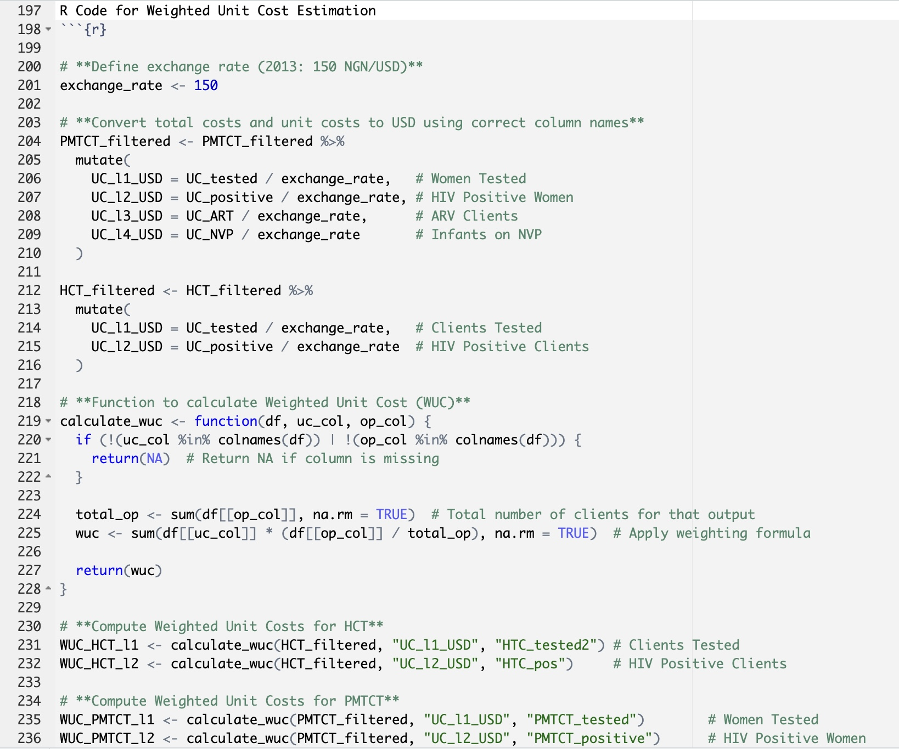
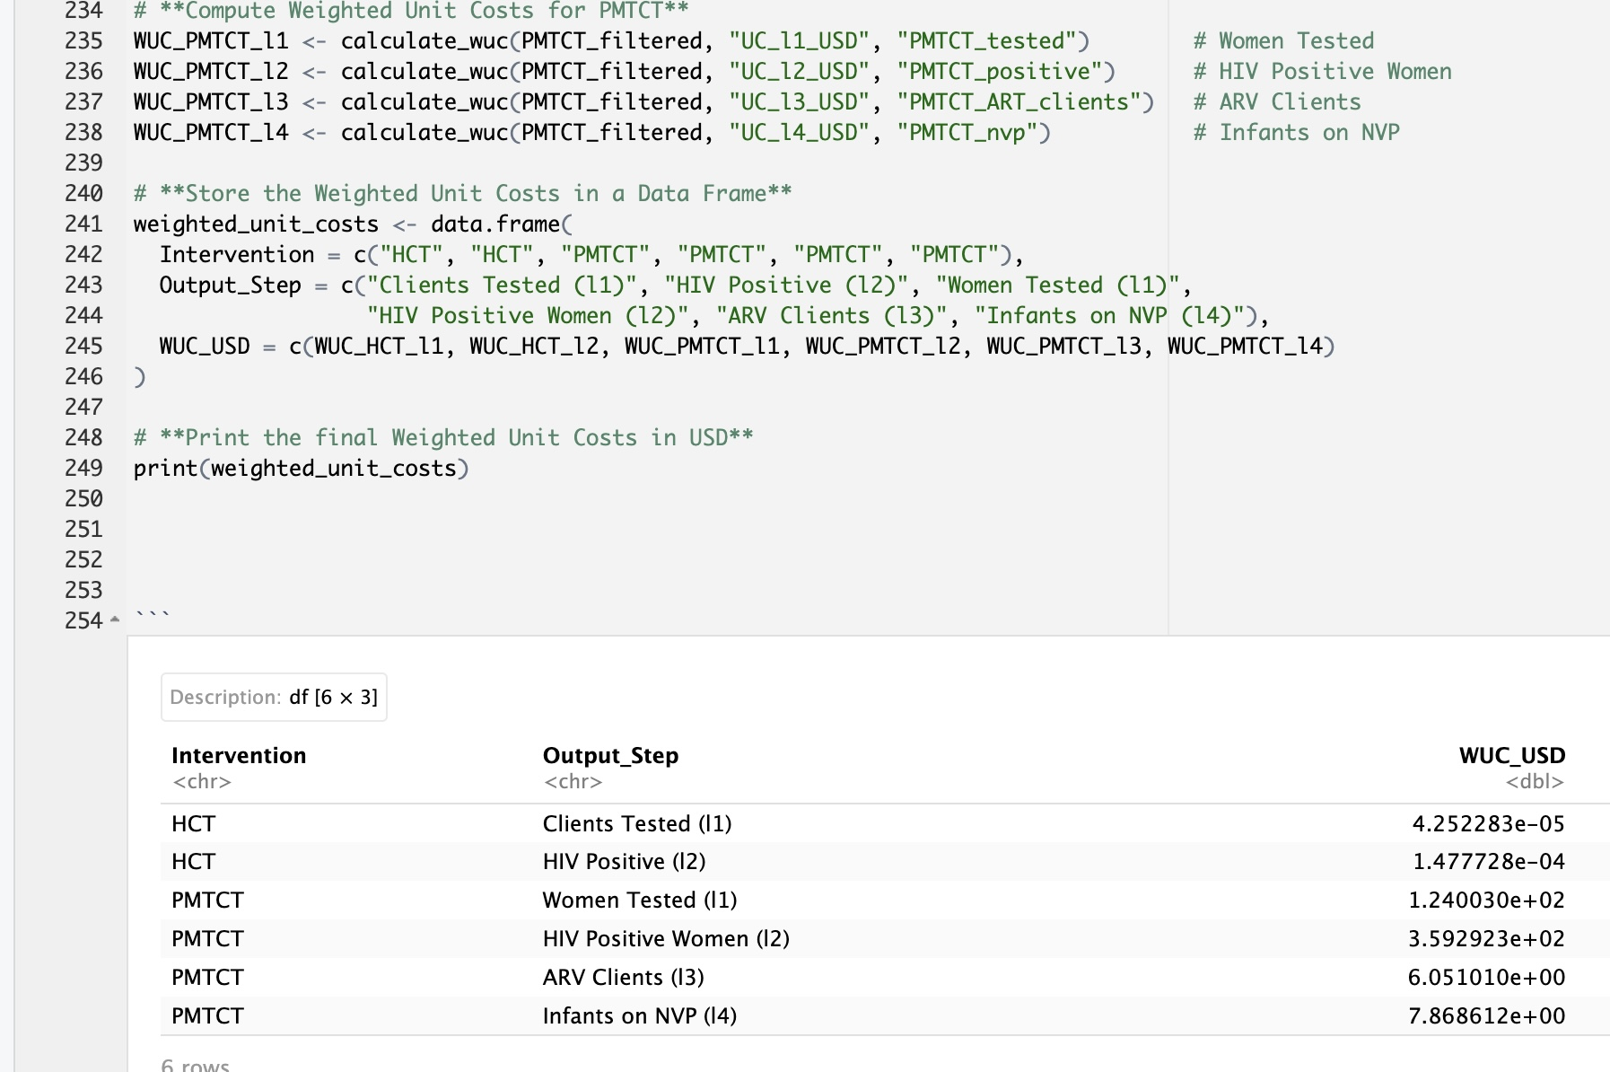

Slide 13
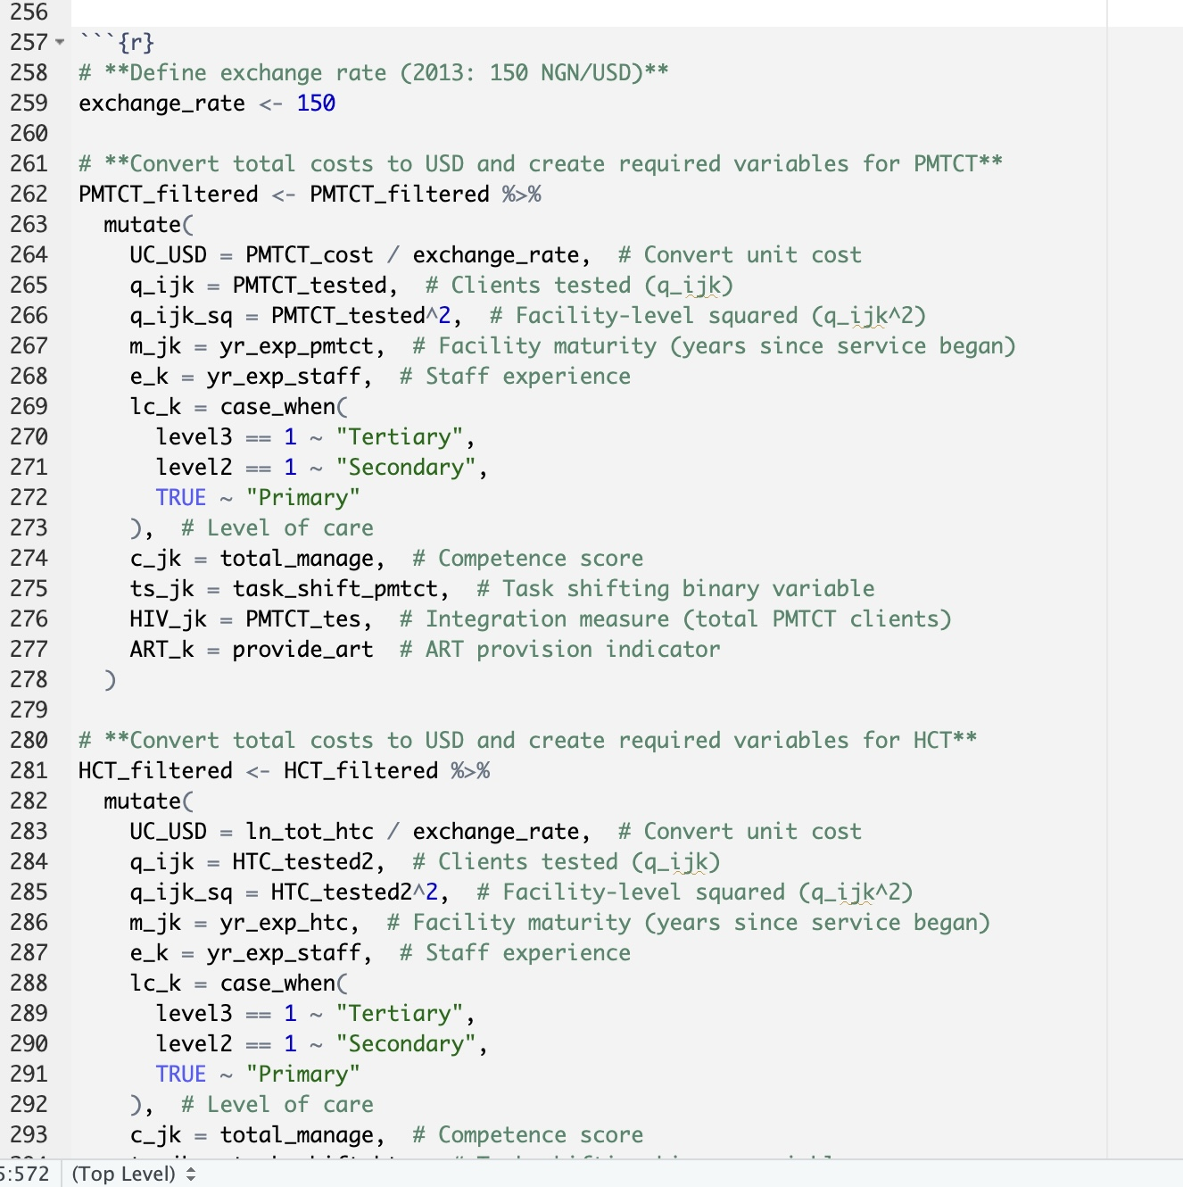
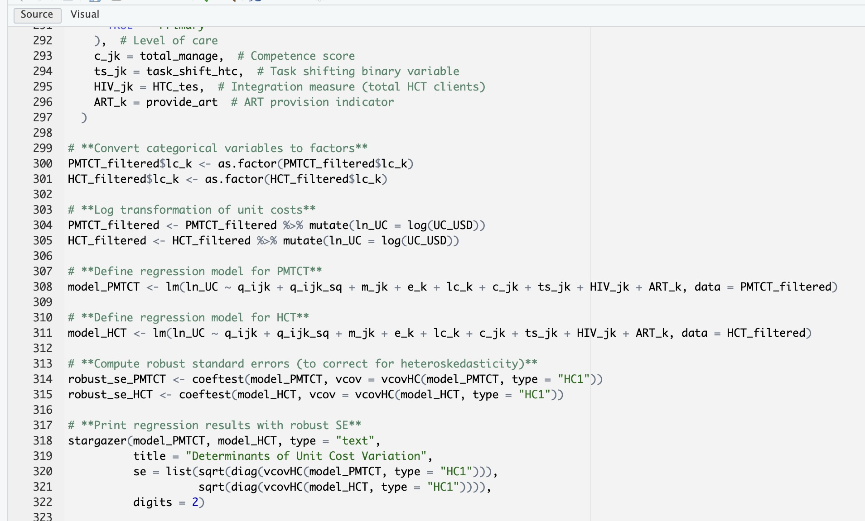

Slide 14
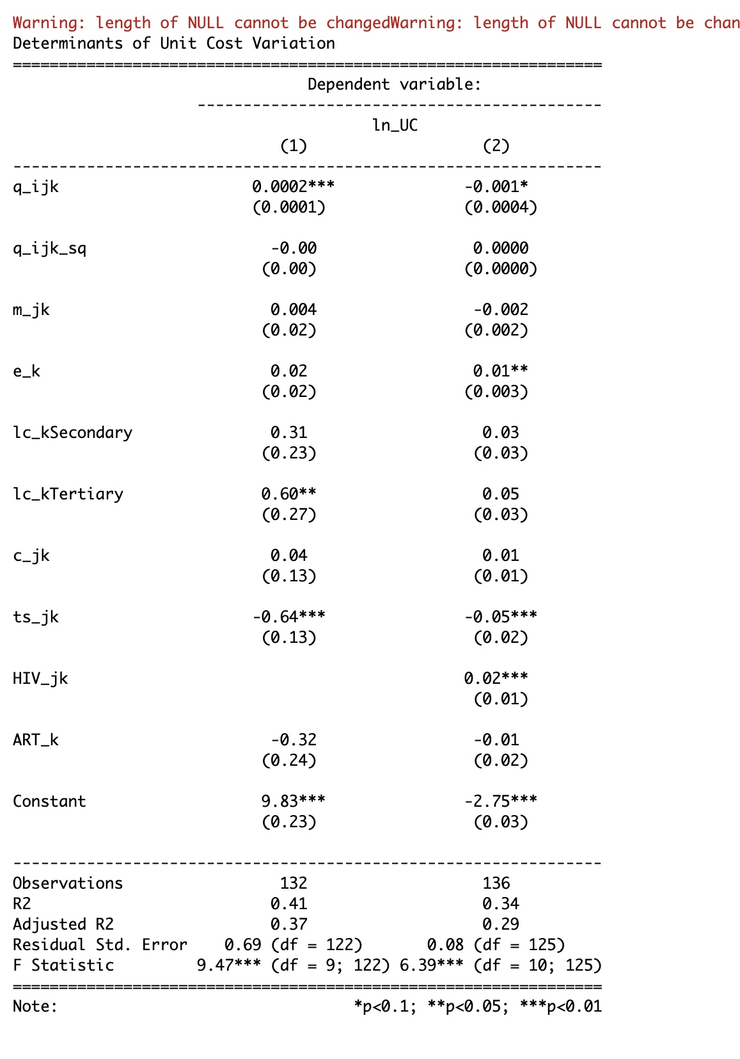
UCijk→ Unit cost per output, i, per intervention; j, in facility k.
qijk: Number of clients served at each output level i (clients tested, HIV-positive, ARV, NVP).
mjk → Years since the facility started HIV services (facility maturity).
ek → Average staff experience in years.
lck→ Facility's level of care (Primary, Secondary, Tertiary).
cjk→ Competence score of the facility.
tsjk→ Task shifting (binary: 1 = used, 0 = not used).
HIVjk→ Annual number of HIV clients (measure of integration).
ARTk → Binary indicator for ART provision.
Interpretation:
Staff experience significantly increases costs in PMTCT.
Tertiary care is significantly more expensive for HCT services.
Task shifting significantly reduces costs in PMTCT.
Facility size and number of clients have no strong non-linear cost effects.
RT provision does not significantly affect unit costs.

Slide 15
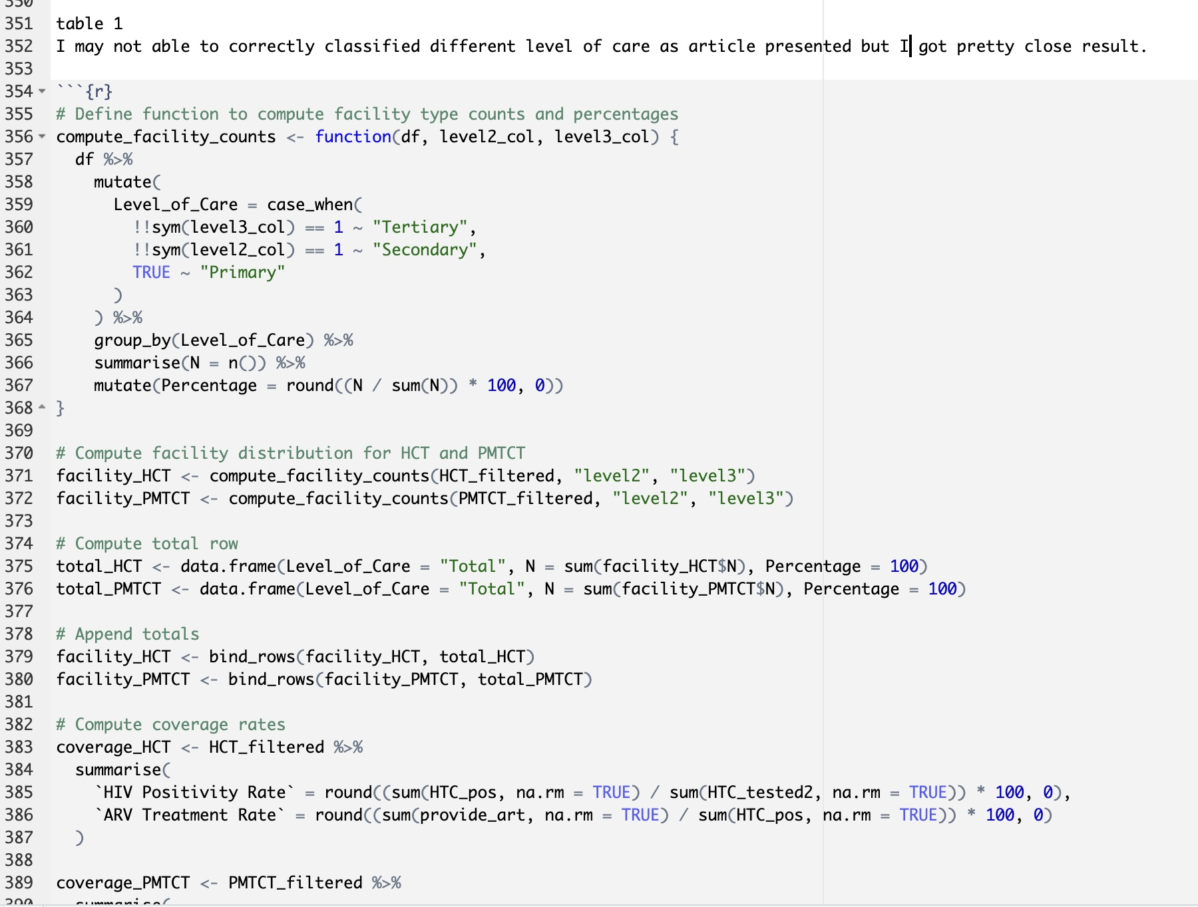
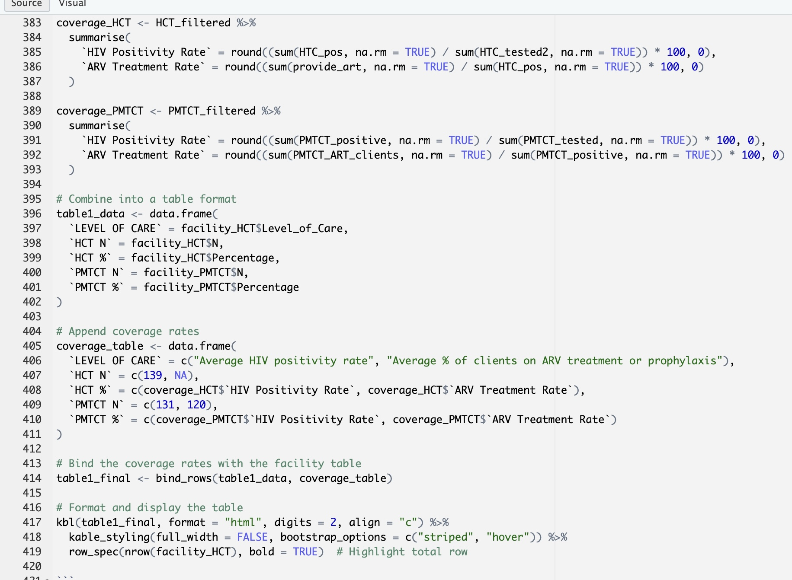
Figure 1

Slide 16
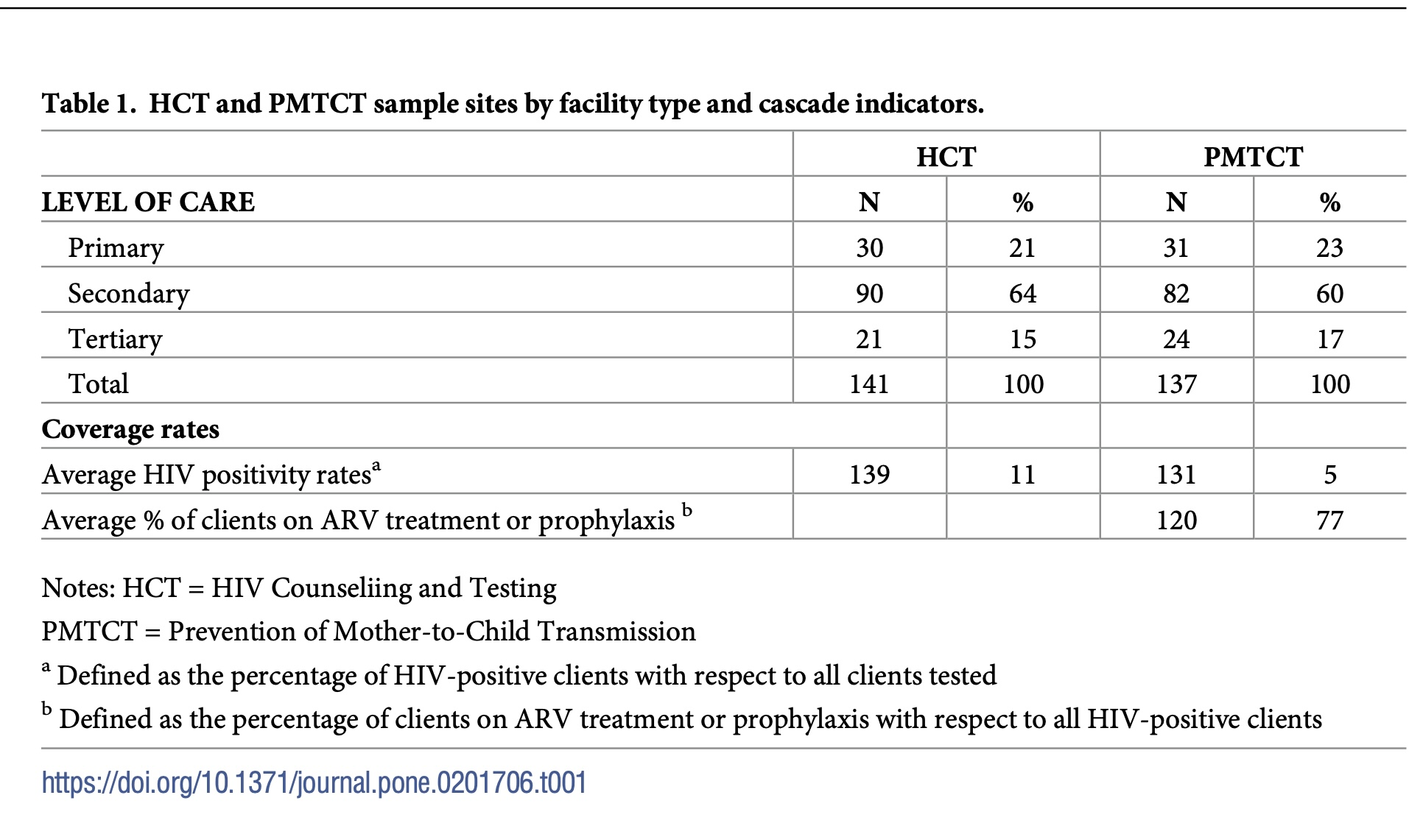
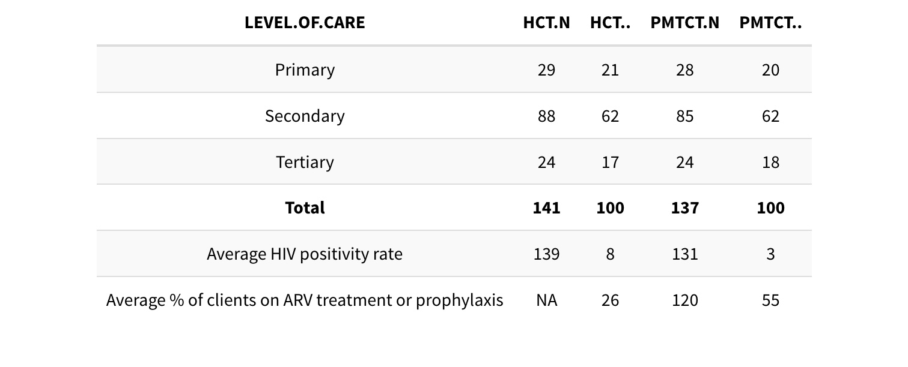

Slide 17
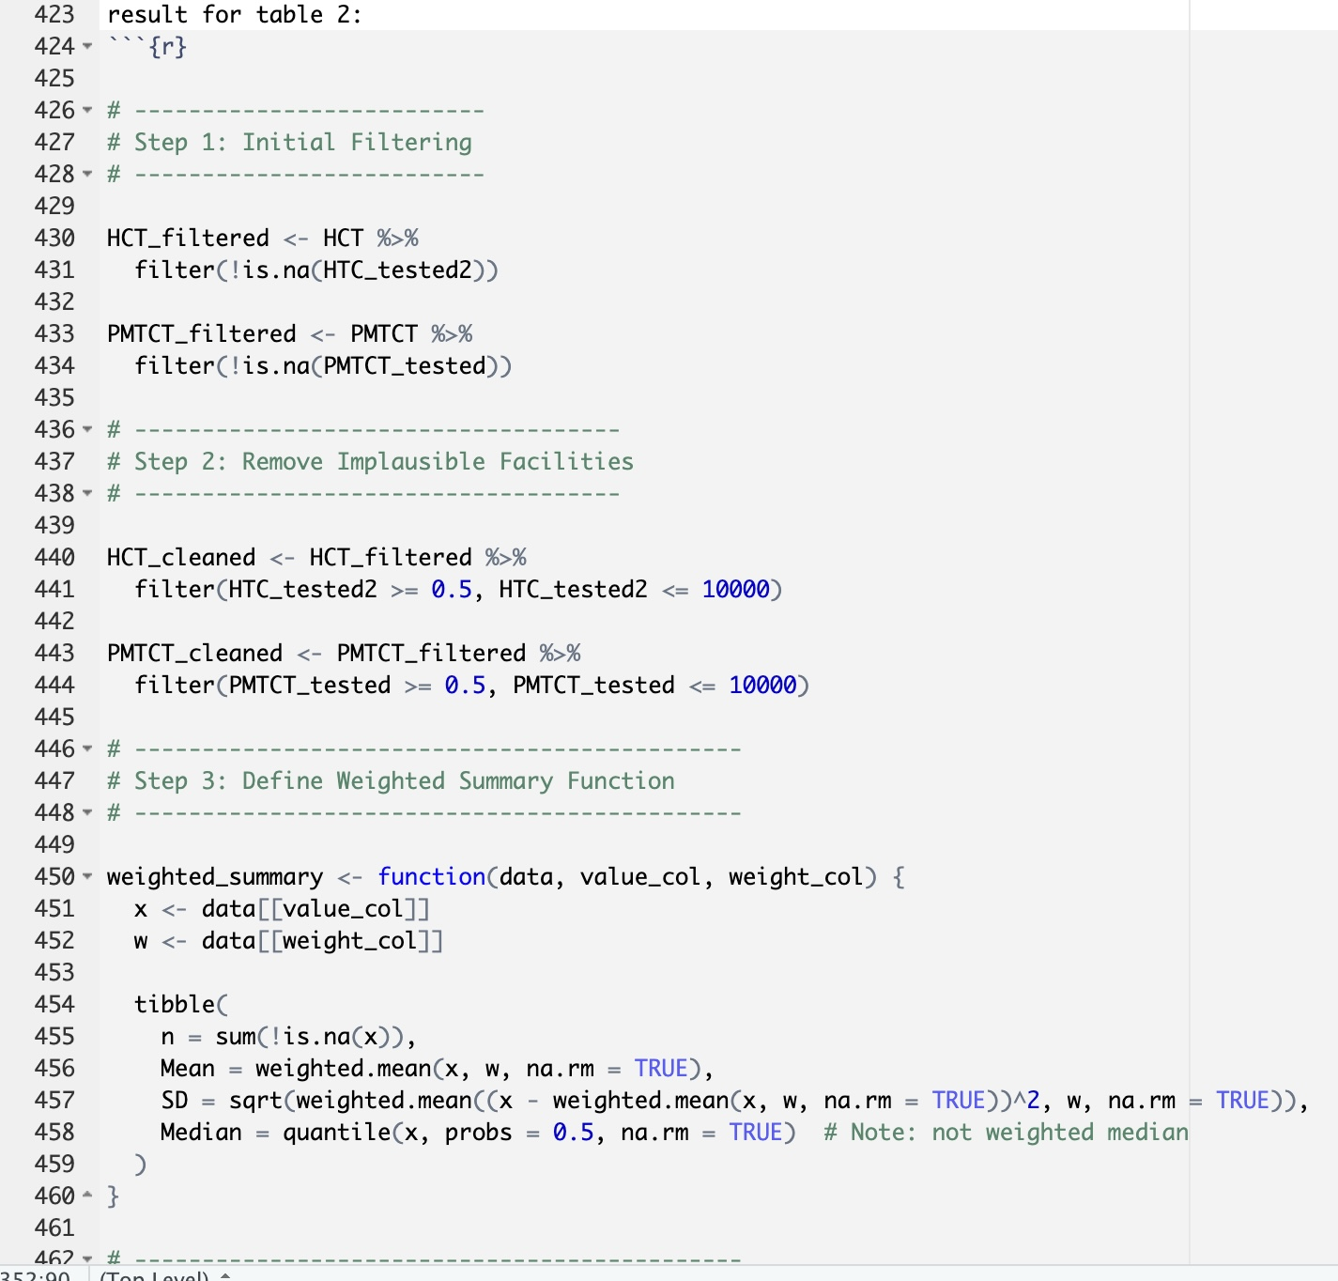
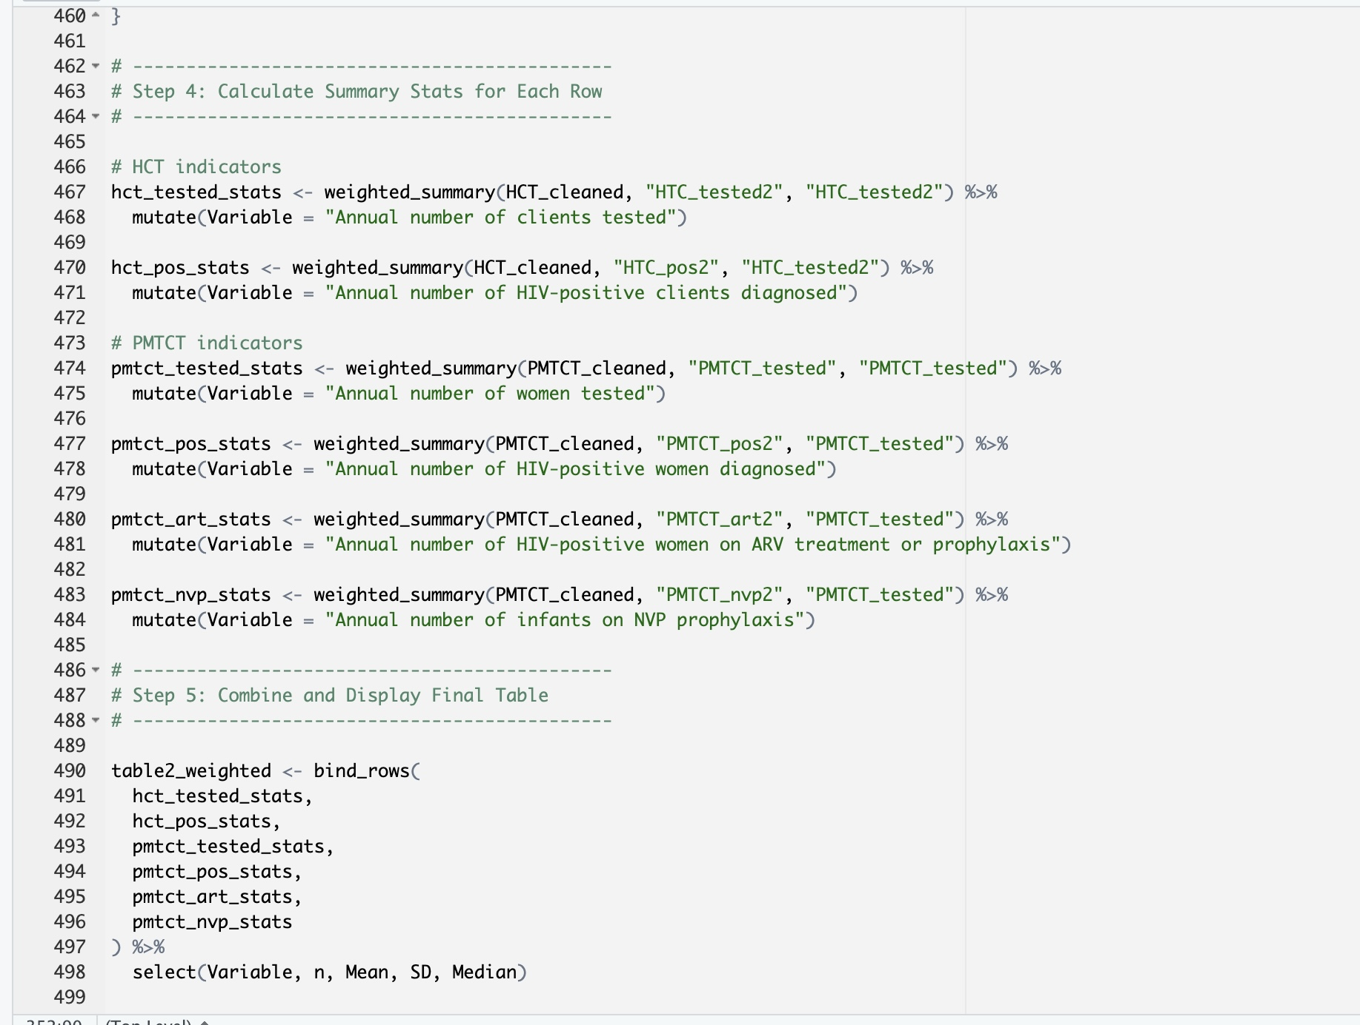

Slide 18
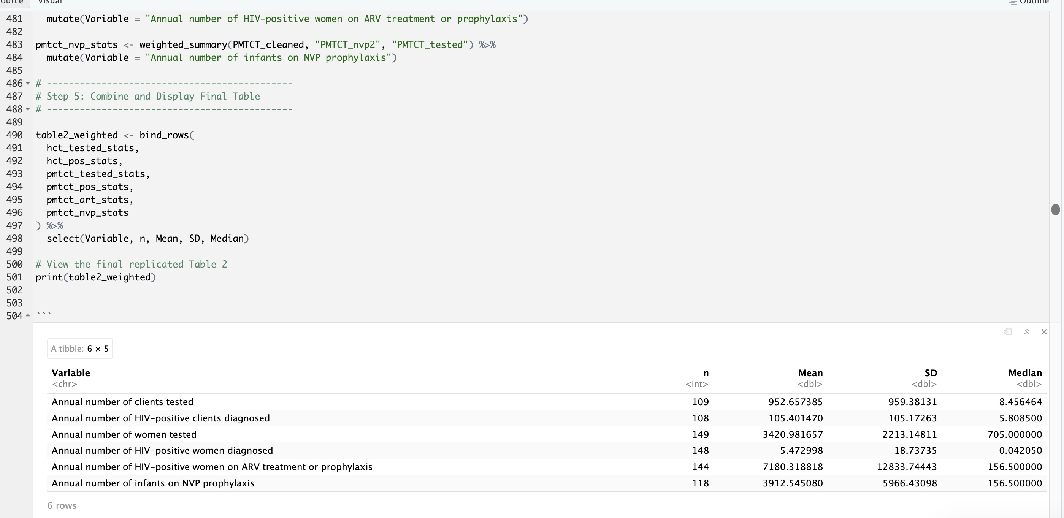
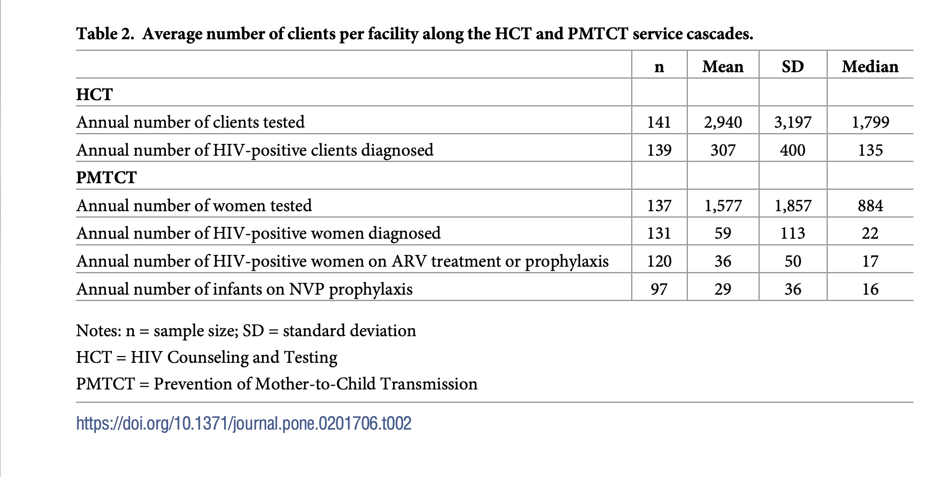
The reason caused the difference: In the article, sample size n decreases with each step of the cascade due to attrition:
Not all facilities report infant-level data.
Some facilities report ART data, some do not.
My data set may not perfectly follow this attrition pattern unless further filtered.

Slide 19
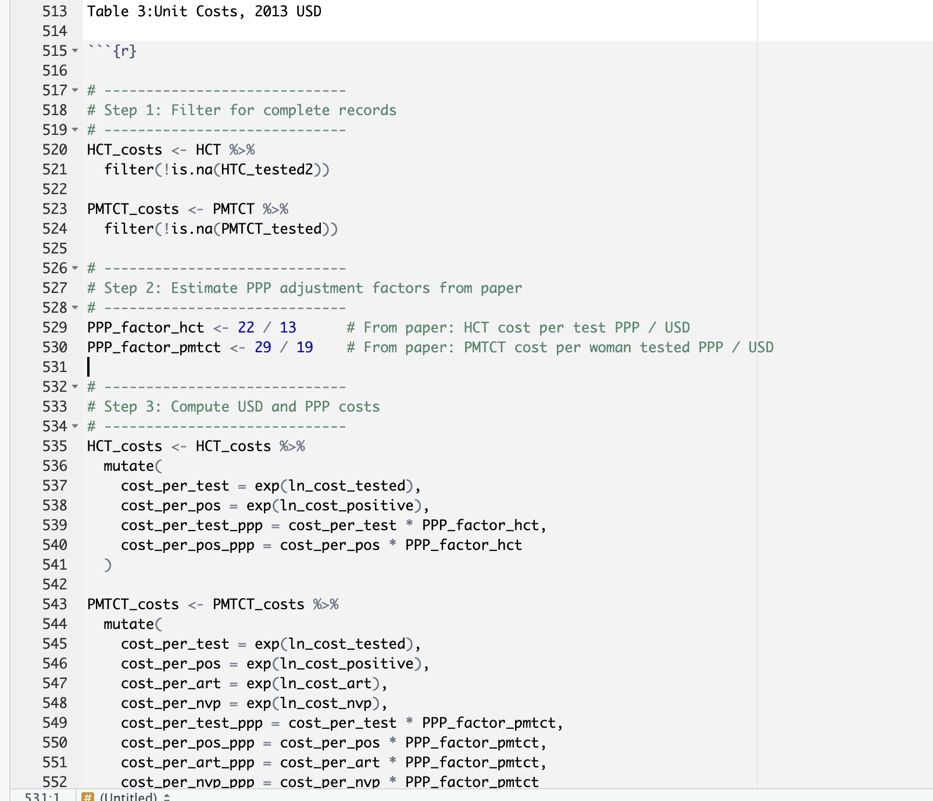
# -----------------------------
# Step 4: Weighted summary function
# -----------------------------
weighted_summary <- function(data, value_col, weight_col) {
x <- data[[value_col]]
w <- data[[weight_col]]
tibble(
n = sum(!is.na(x)),
`Weighted Mean` = weighted.mean(x, w, na.rm = TRUE),
Mean = mean(x, na.rm = TRUE),
SD = sd(x, na.rm = TRUE),
Median = median(x, na.rm = TRUE)
)
}

Slide 20
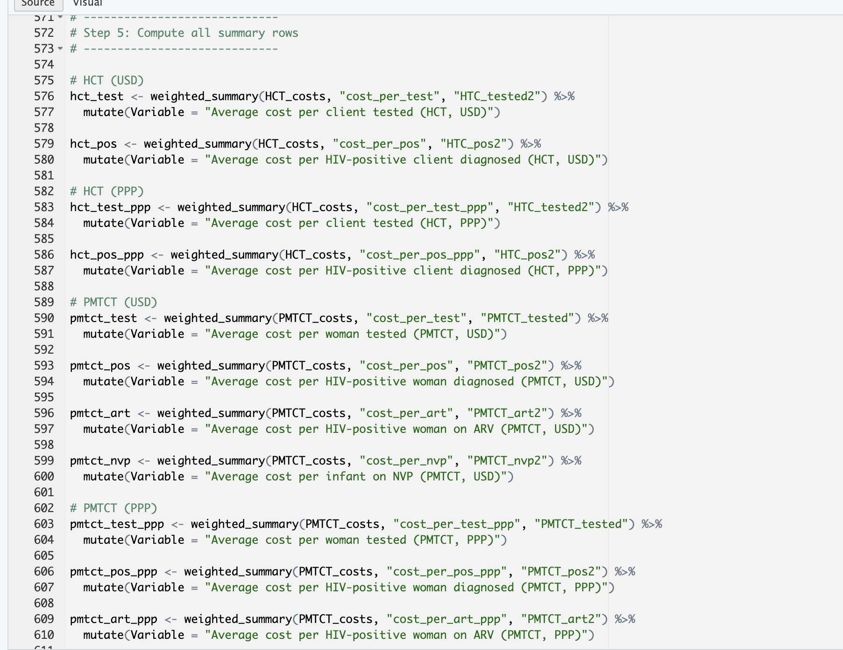
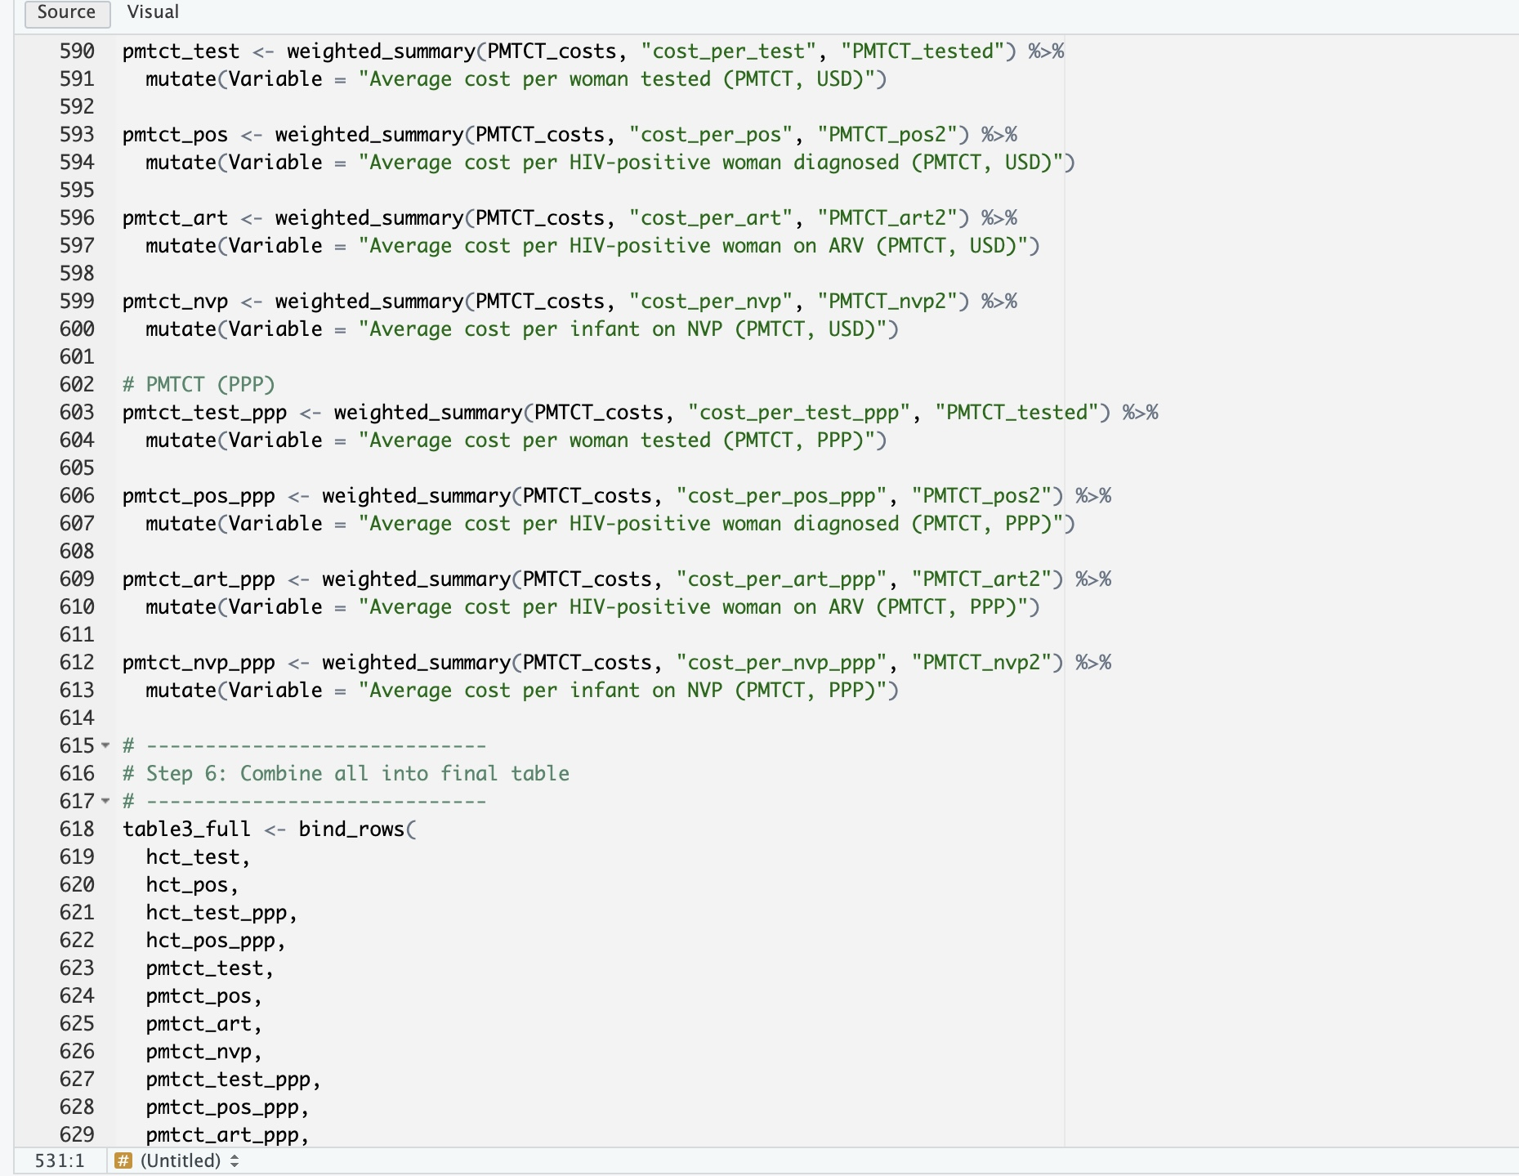

Slide 21
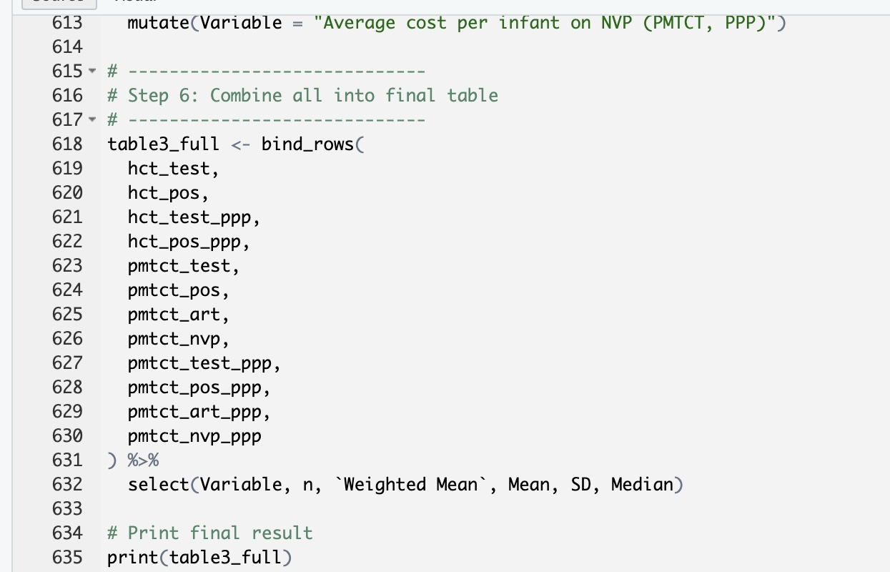

Slide 22
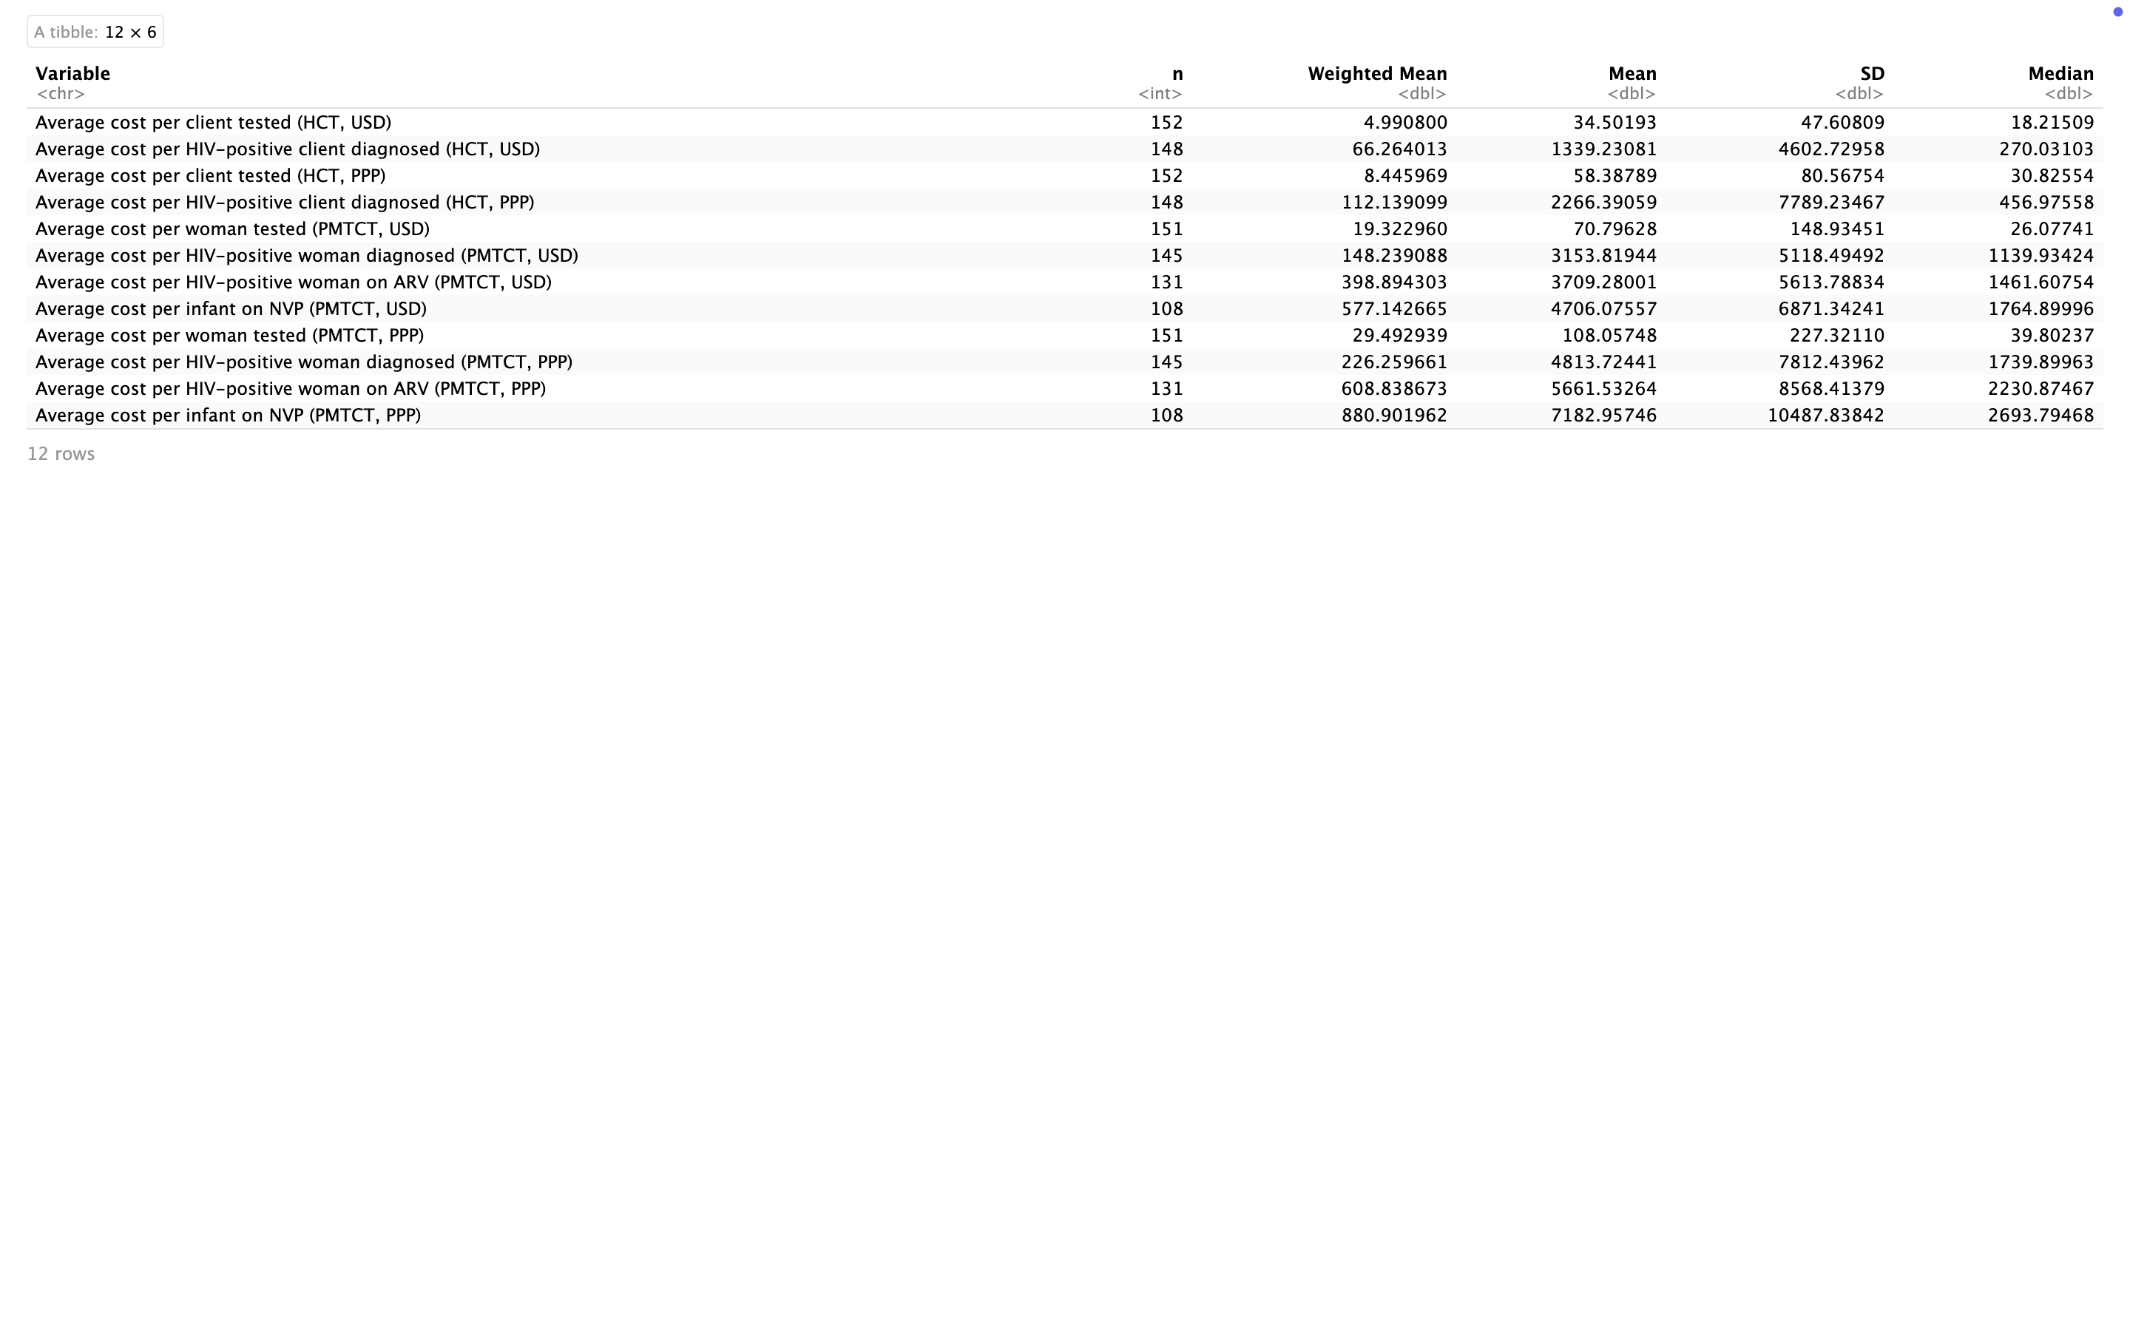
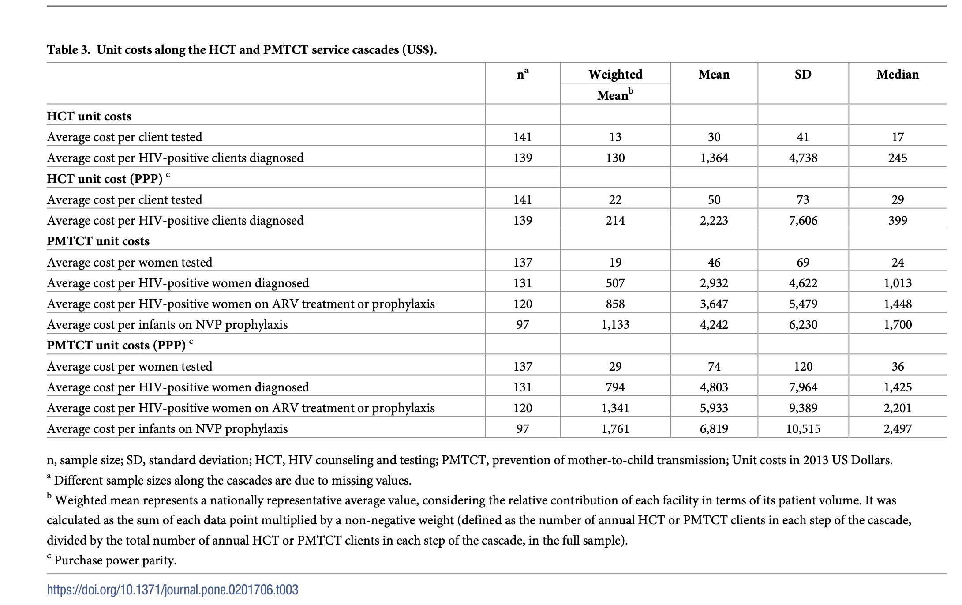
Different Data Cleaning and Exclusion Criteria
The paper excluded implausible or incomplete records (e.g., outliers, missing time-motion data, extreme unit costs).
my replication likely includes all rows with non-missing values, so:
I might also include small clinics with low output or odd costs.
This can lower the weighted mean and increase the SD.

Slide 23
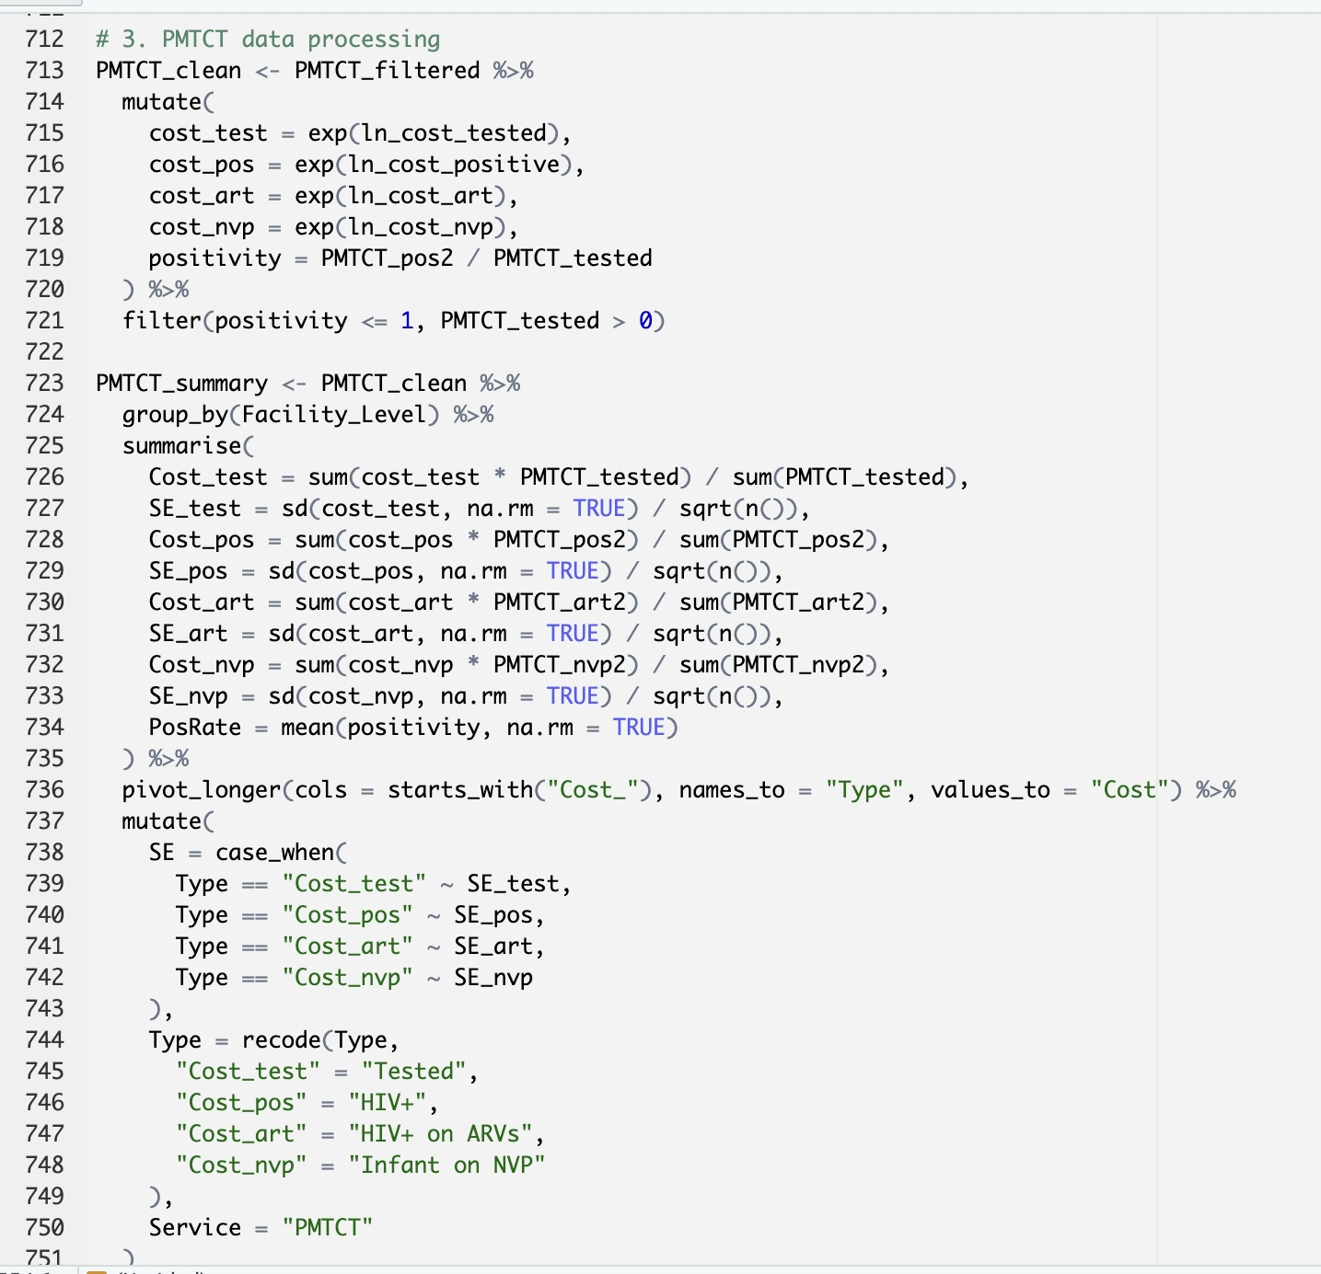
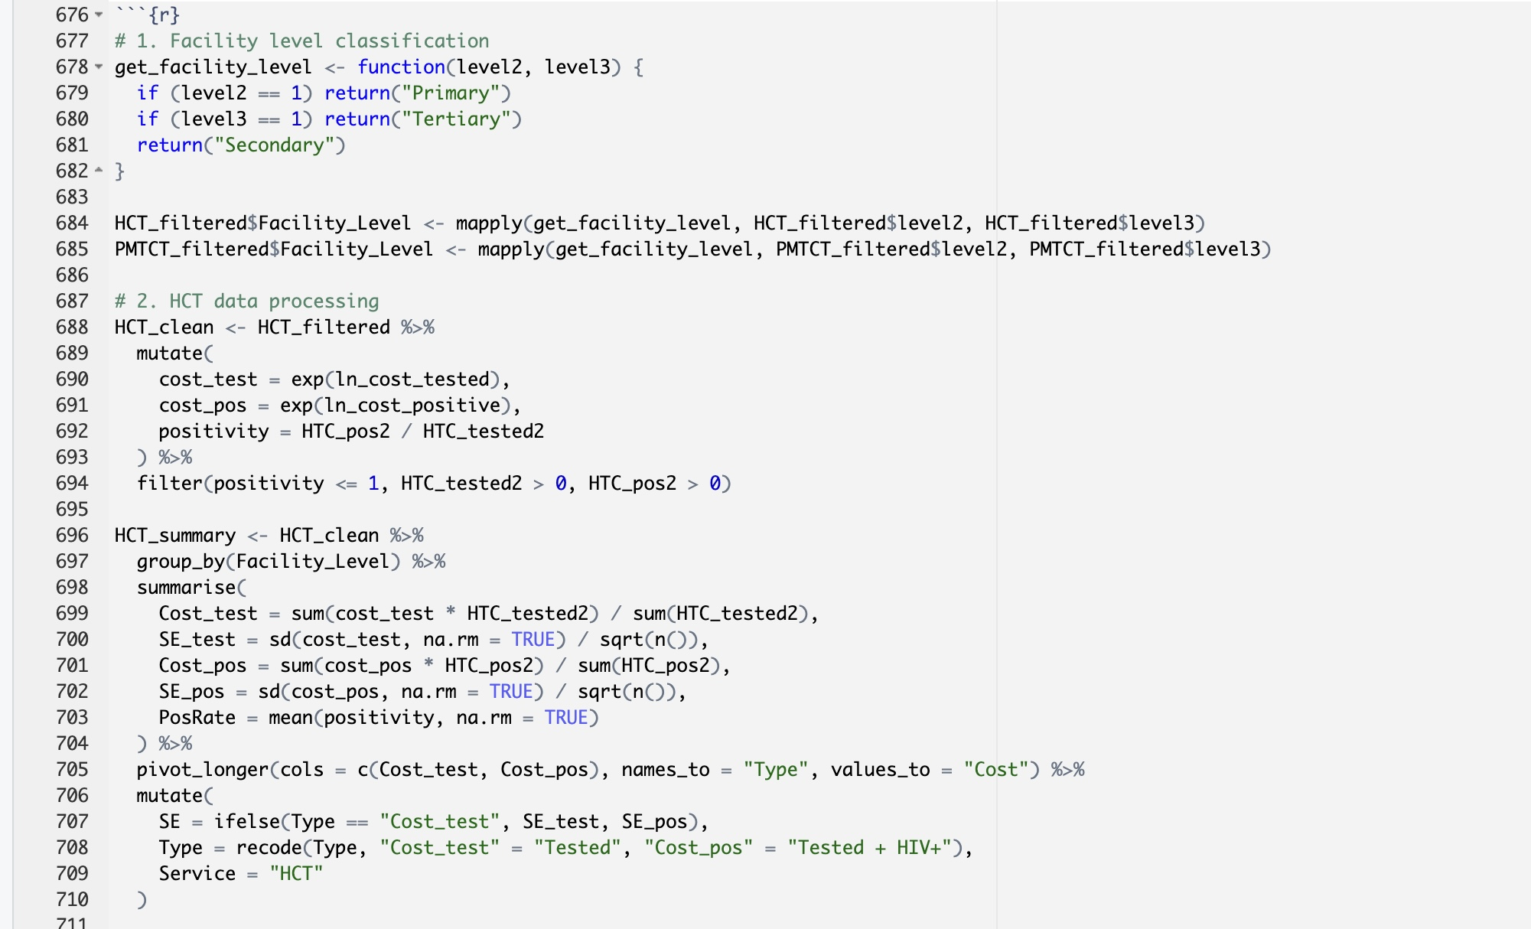
Figure 1

Slide 24
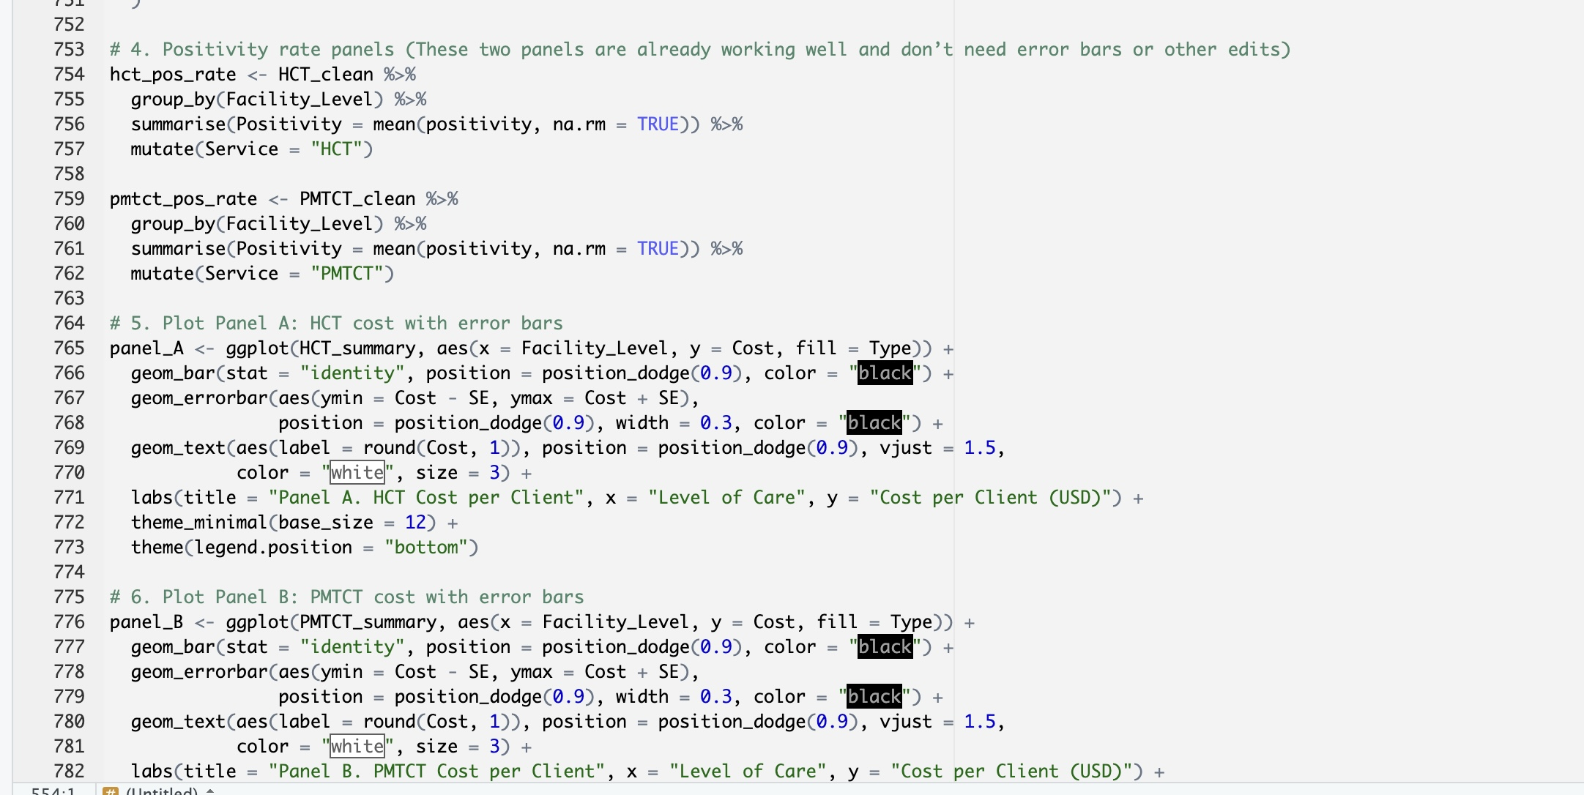
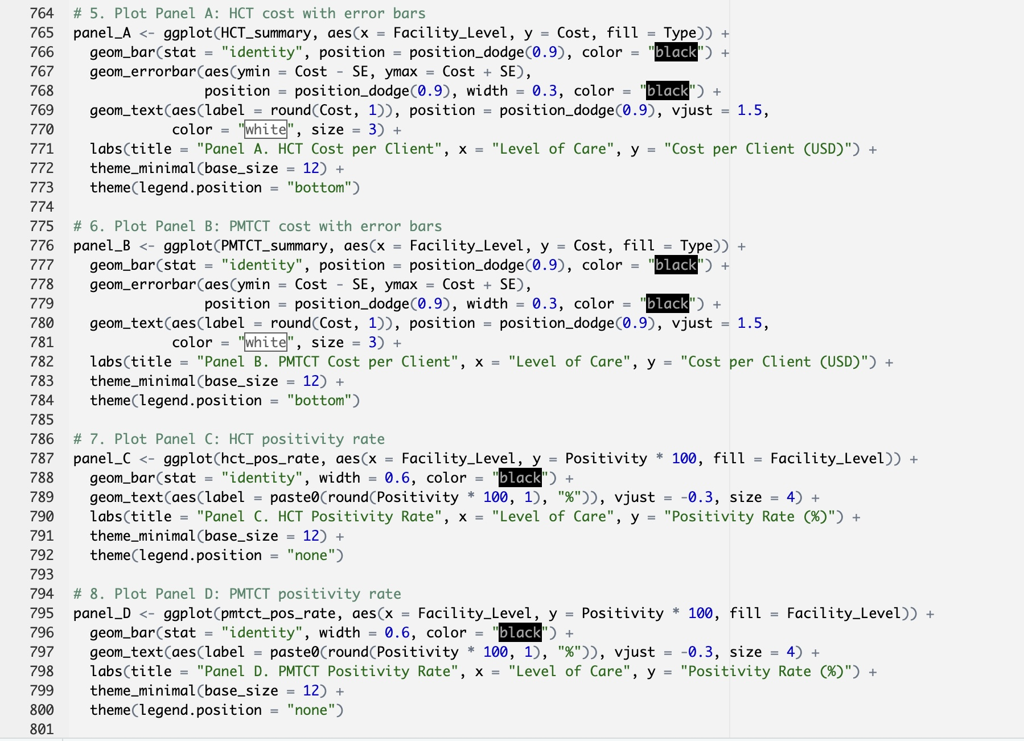
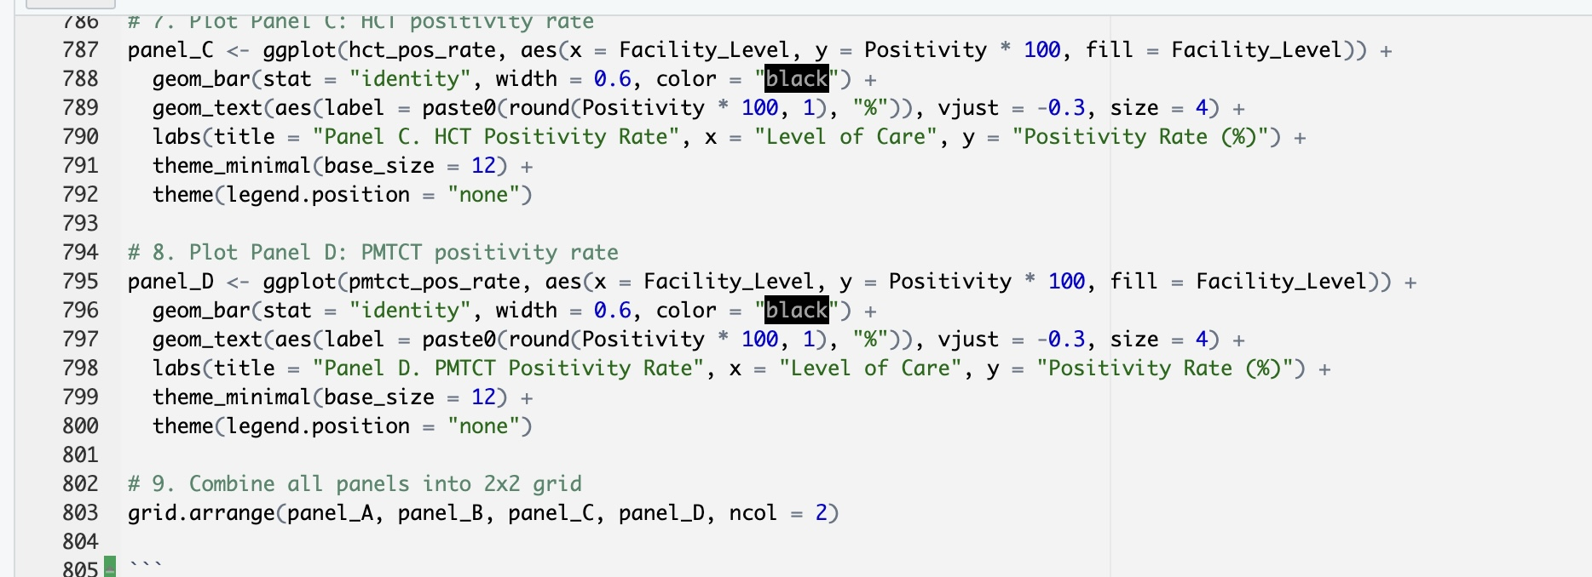

Slide 25
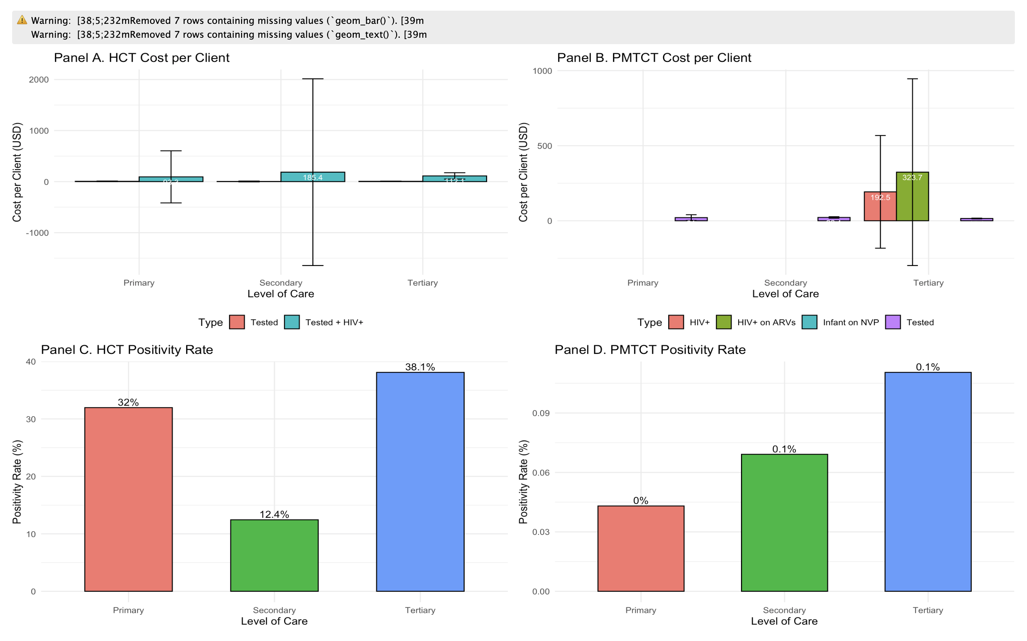
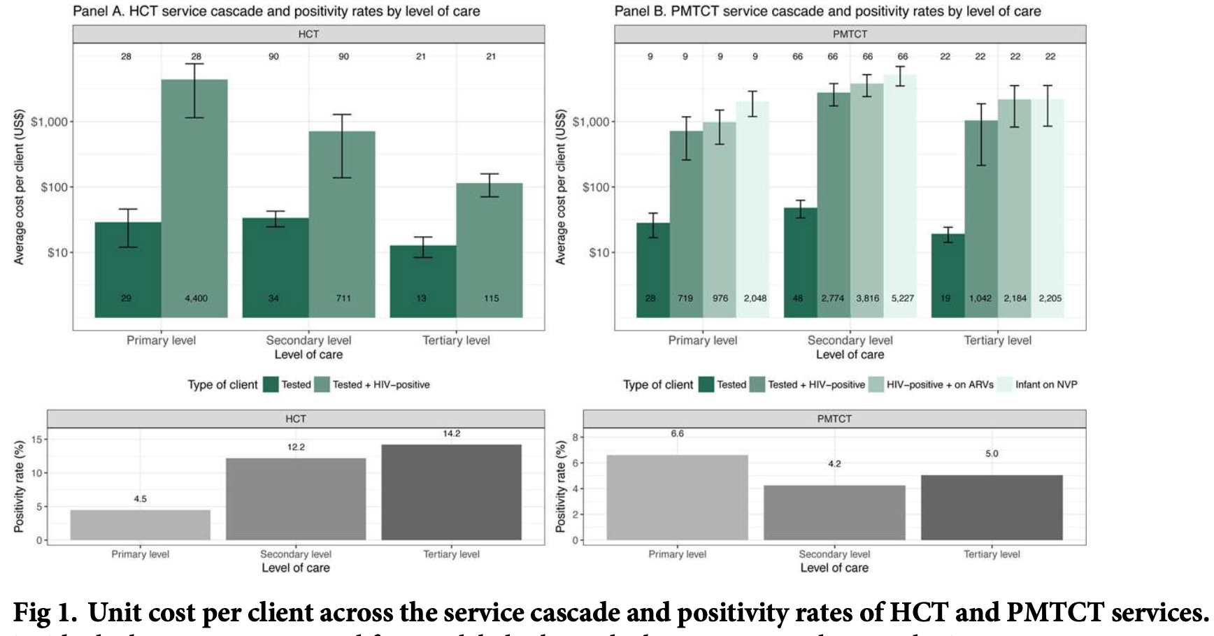
Bars missing: the paper more likely dropped before plotting
Huge SE / wide error bar: They possibly trimmed or capped

Slide 26
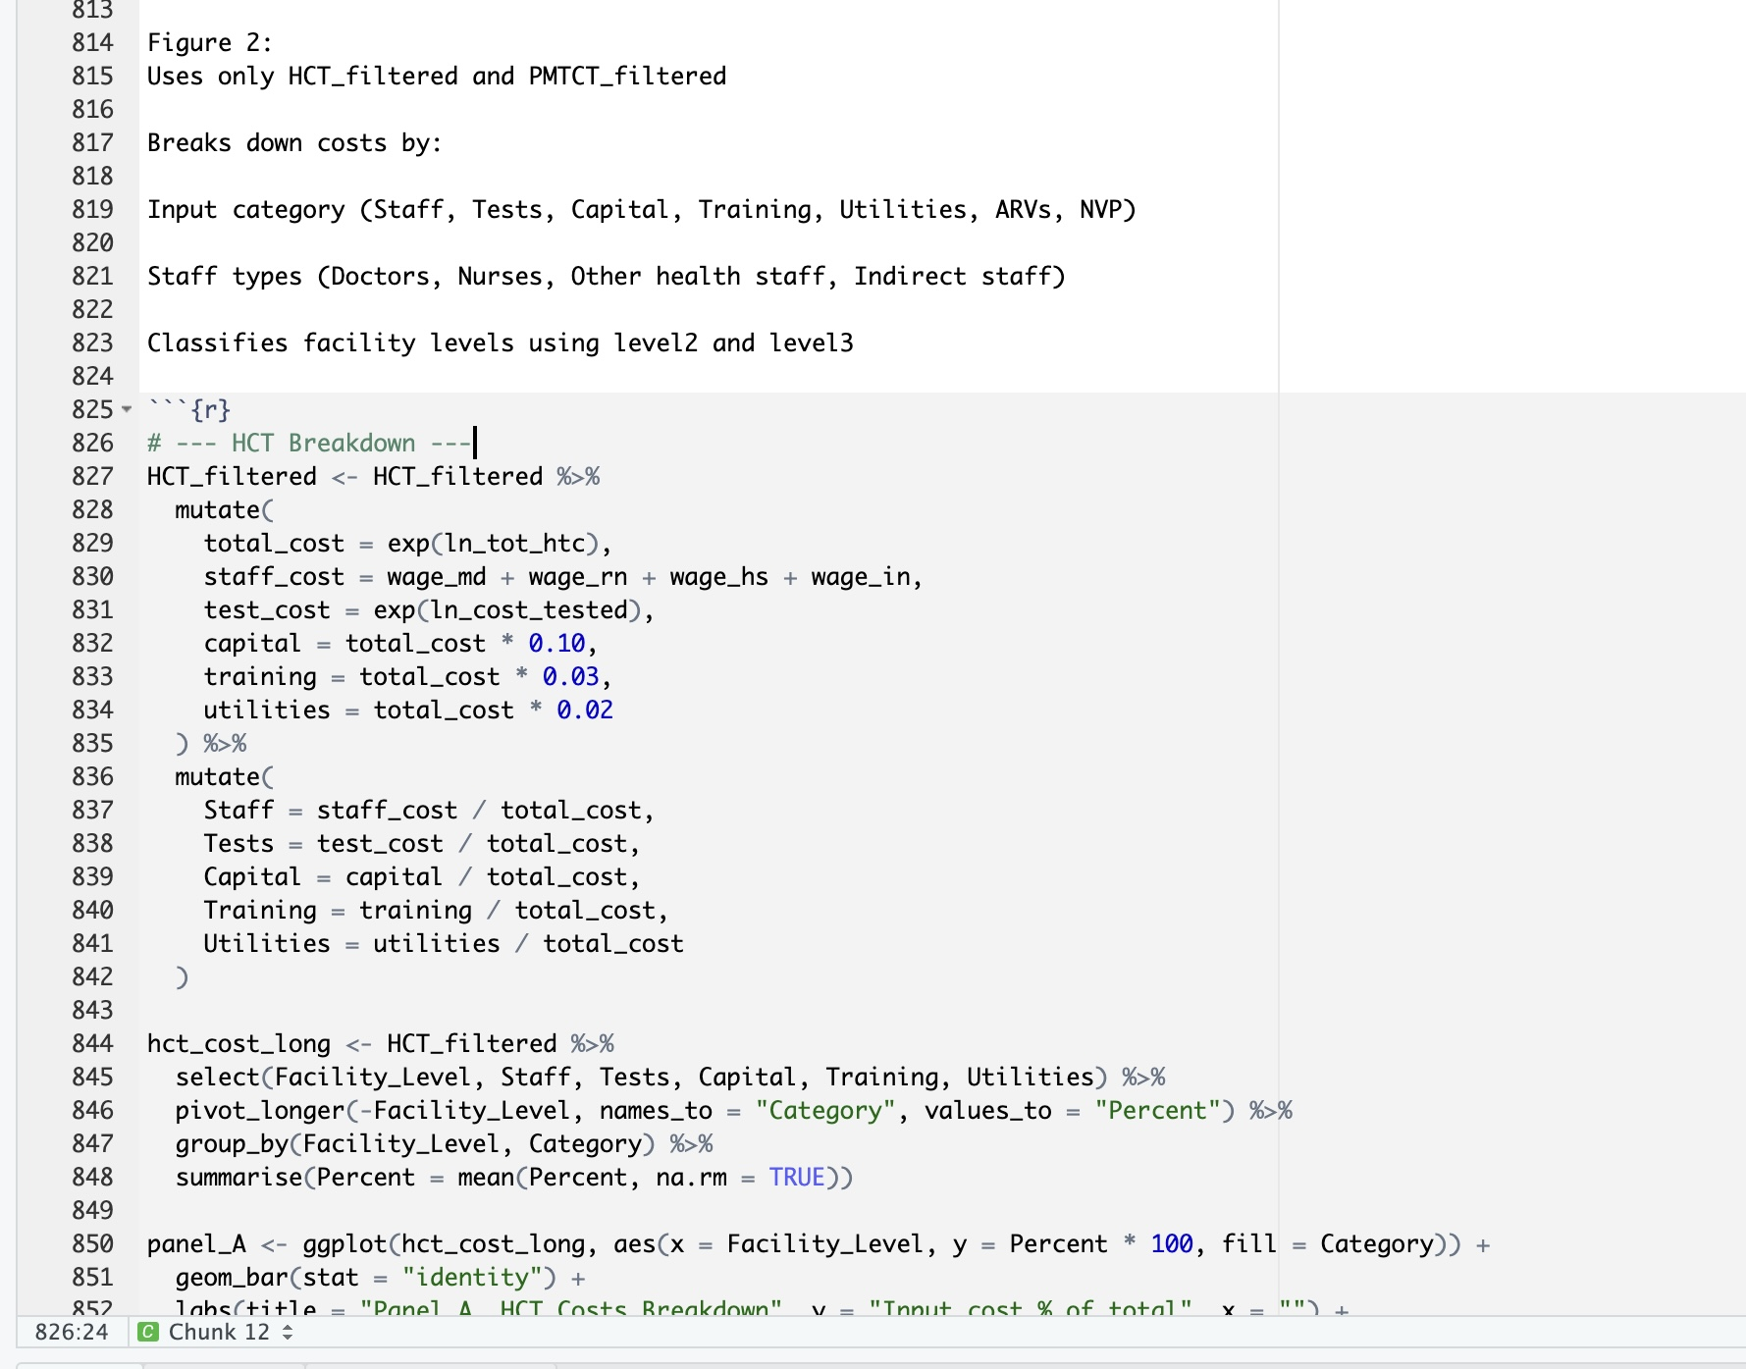
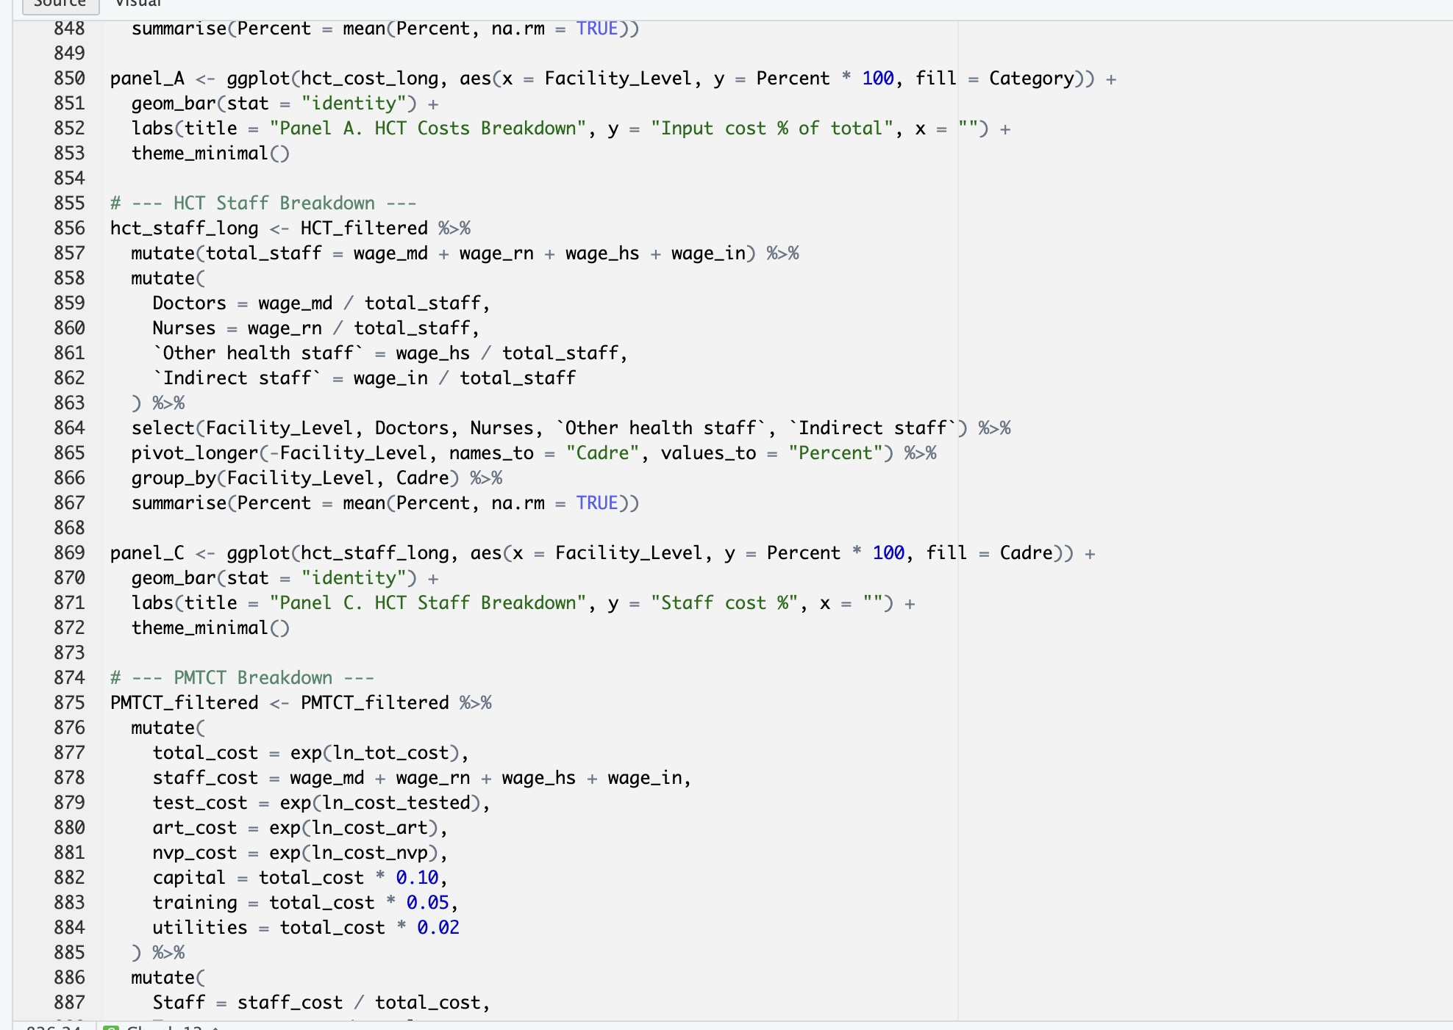

Slide 27
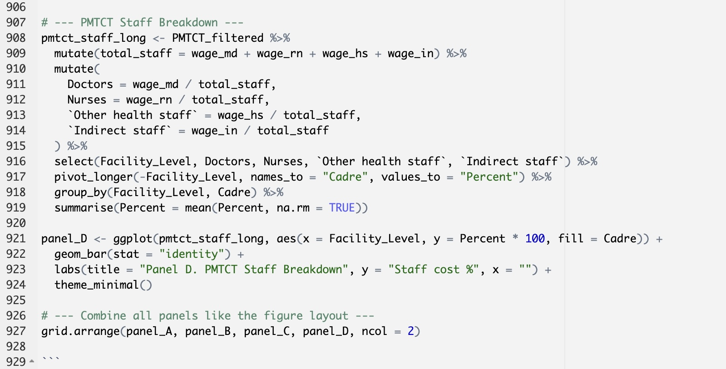

Slide 28
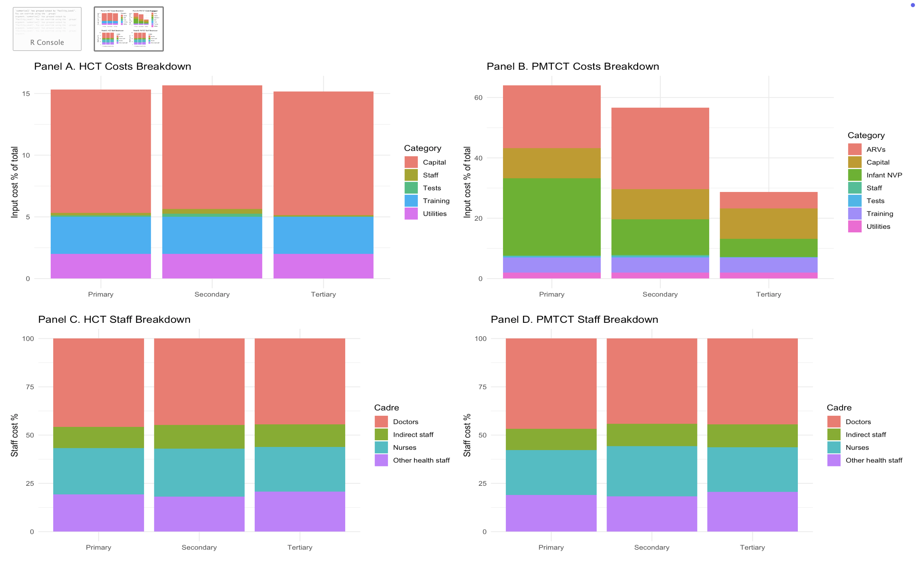
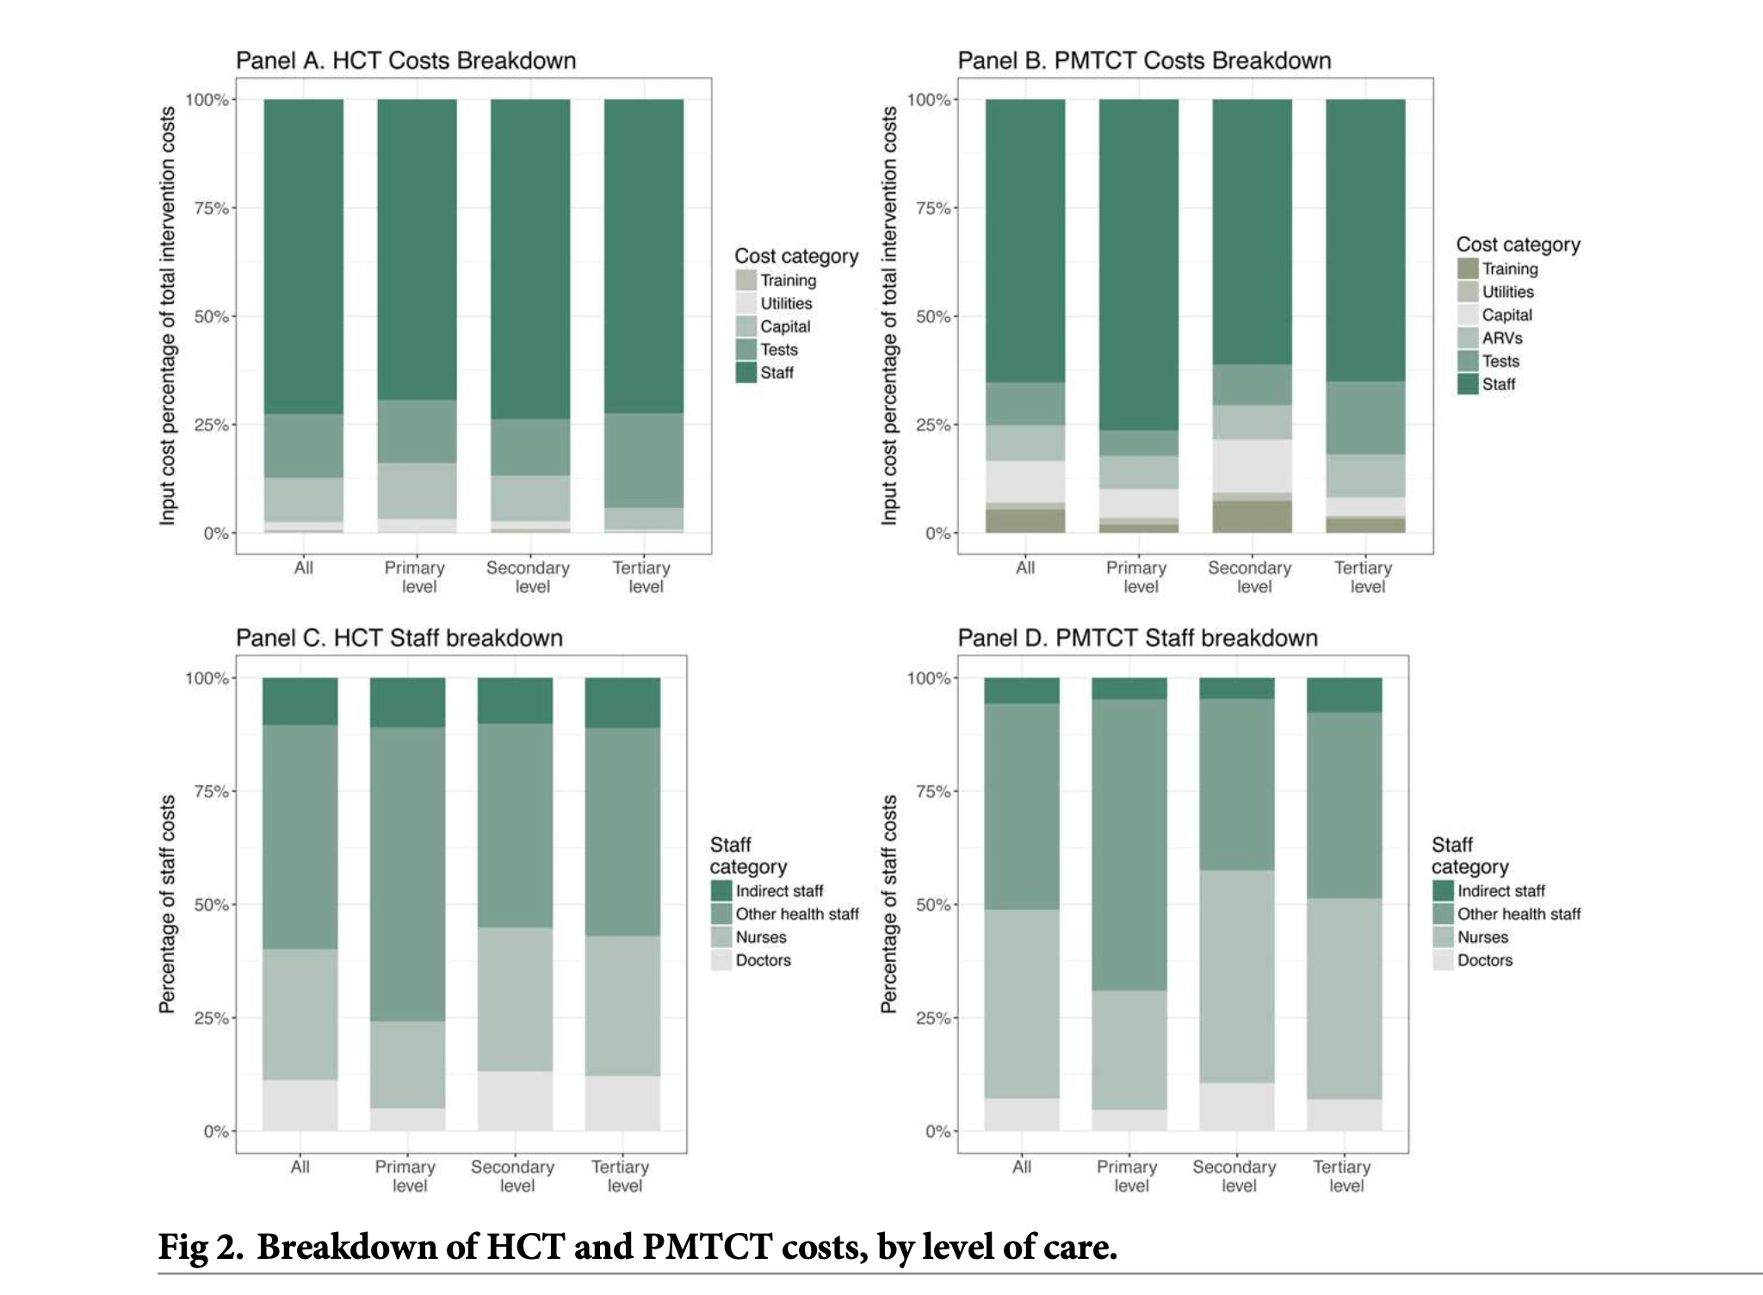

Slide 29
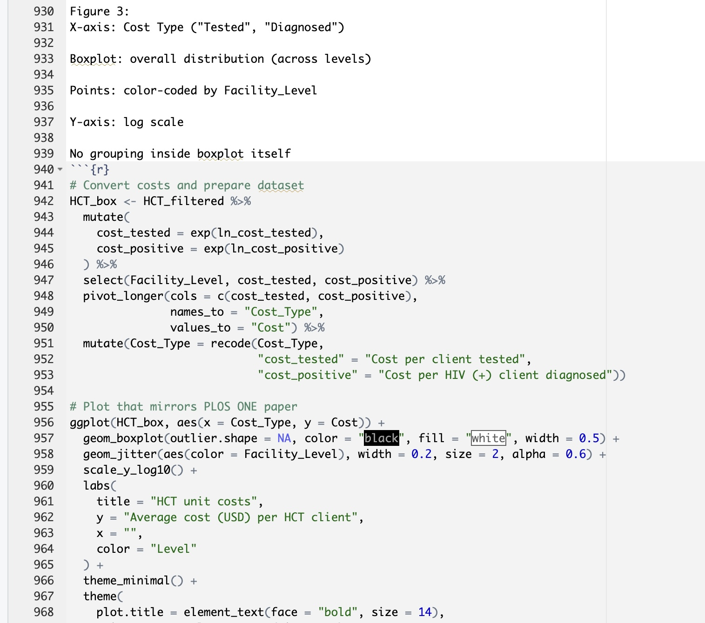

Slide 30
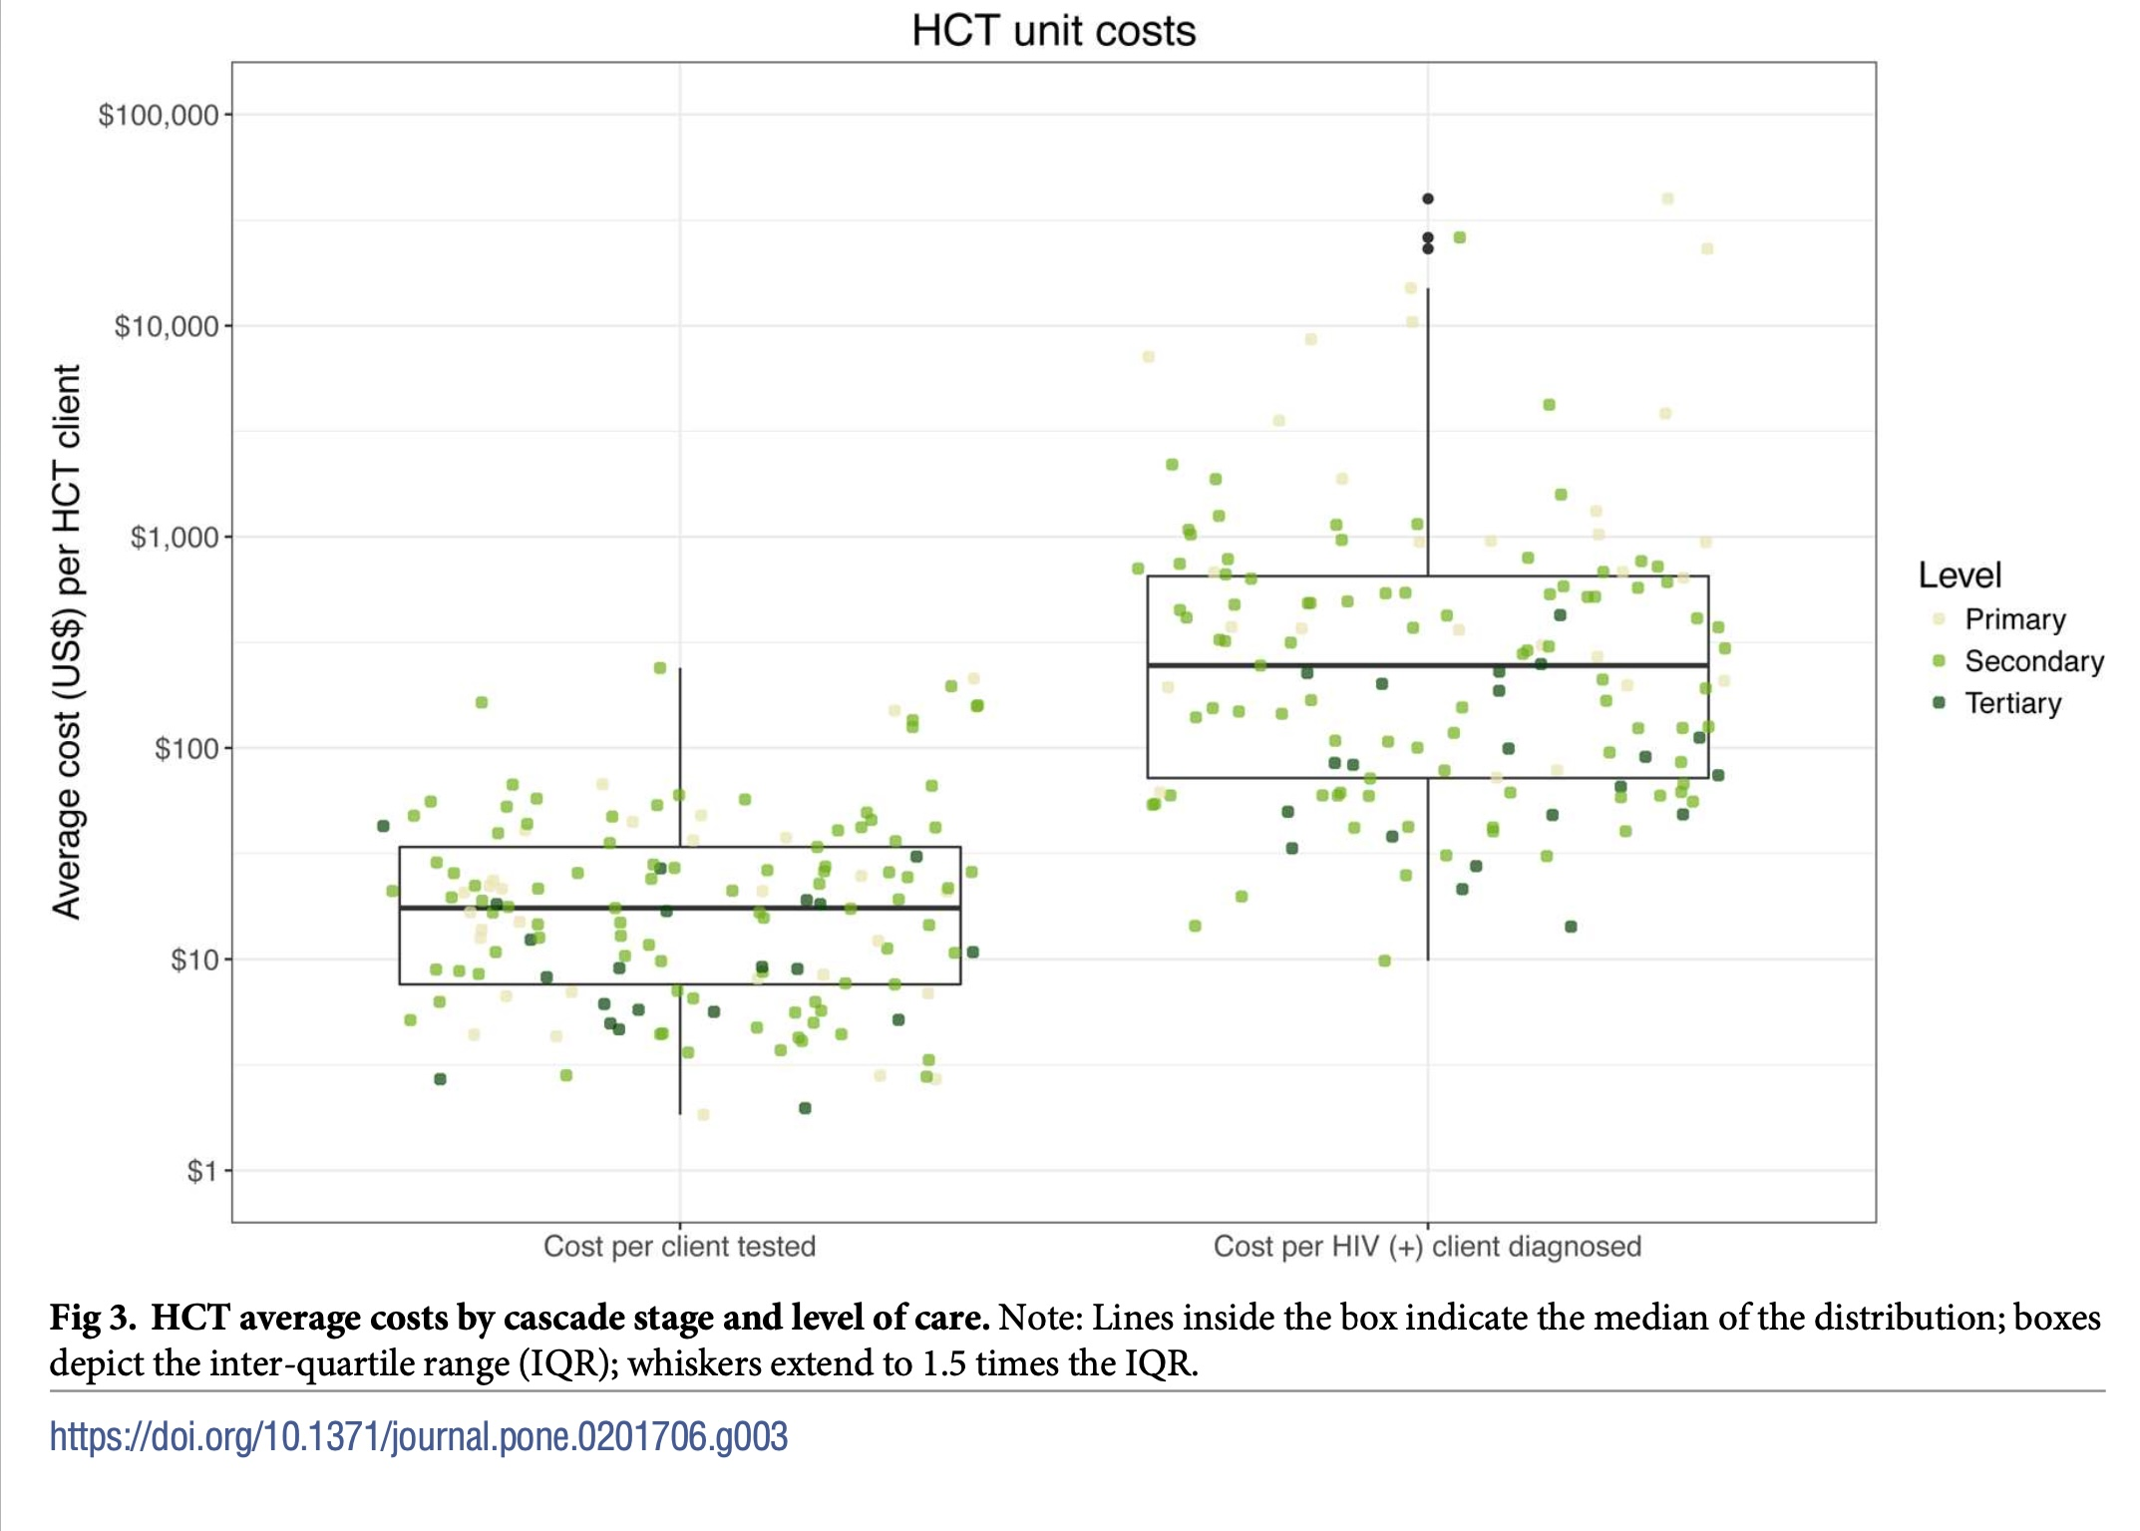
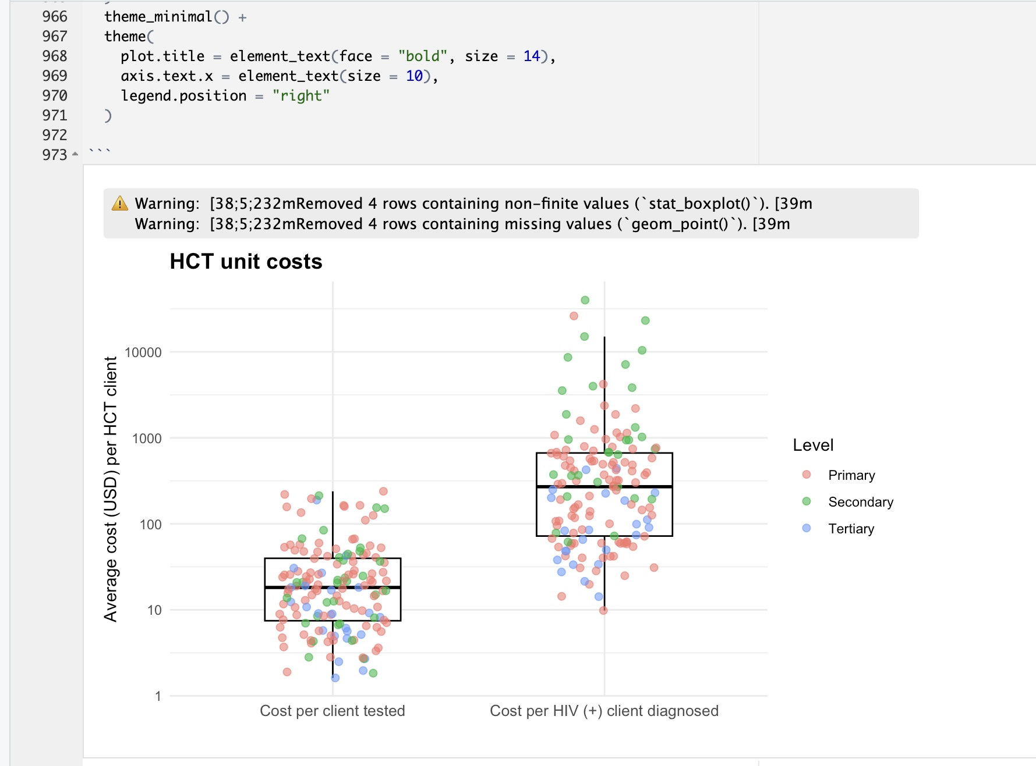

Slide 31
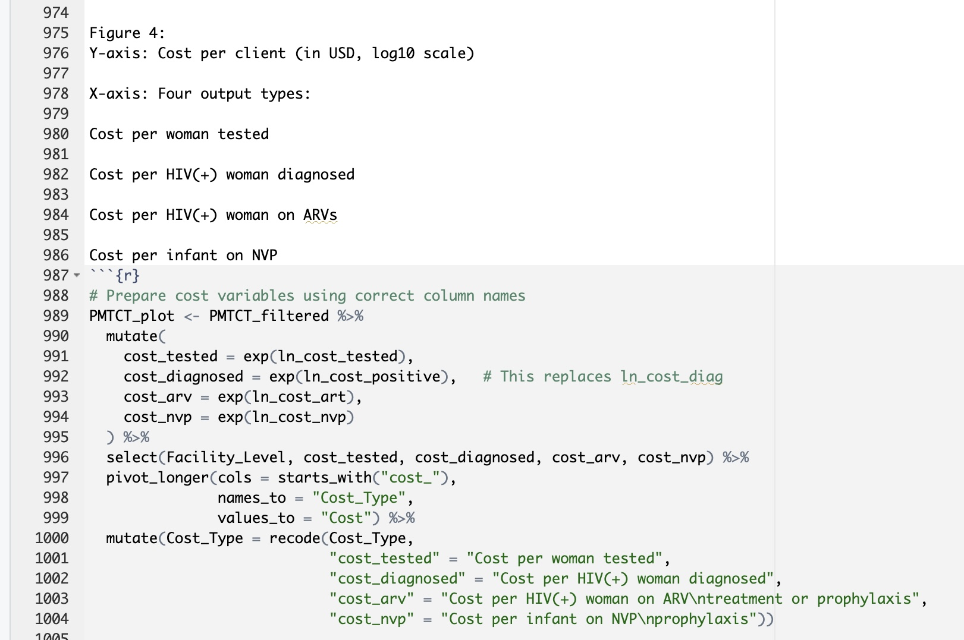
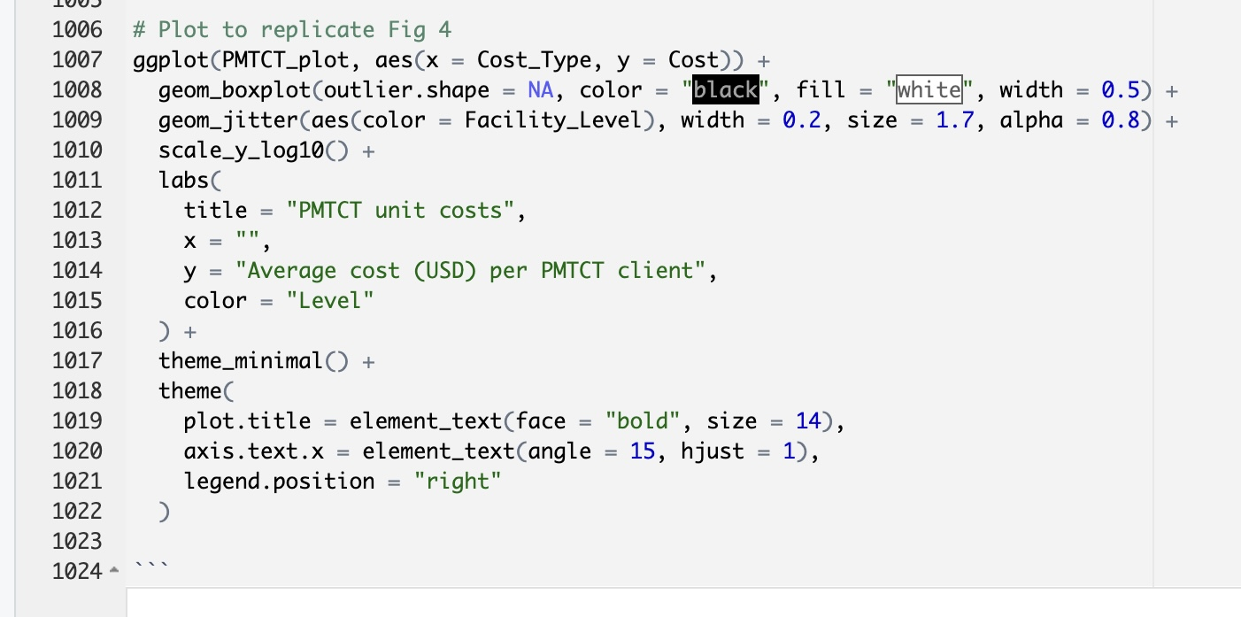

Slide 32



Slide 33



Slide 34


Overall, there is a negative relationship between costs and scale; a greater volume of clients is associated with lower unit costs,

Slide 35



Slide 37



Slide 38



Slide 39



Slide 40



Slide 41


Slide 42



